Slide 1

ERsed Respiration data- 2022
48 observations (sites) in total
Remove positive ERsed values (3 sites with ER_sed >0)
# Missing values: Hyporheic exchange flux (2), Chlorophyll_A(2),TSS(2),
Target variable in the MLR analysis: ERsed_square
Regression variables:
Depth, Velocity, Slope , Discharge
HOBO_Temp (water temperature)
Hyporheic exchange flux, Chlorophyll_A
totdasqkm (total drainage area),
D50_m, aridity, TSS, Stream order
PctMxFst2019Ws (%forest) , PctCrop2019Ws (%crop), PctShrb2019Ws(%Shrb)
GPP
Log transform for Slope, D50_m, totdasqkm, "Discharge", 'Average_Depth' and TSS

Slide 2
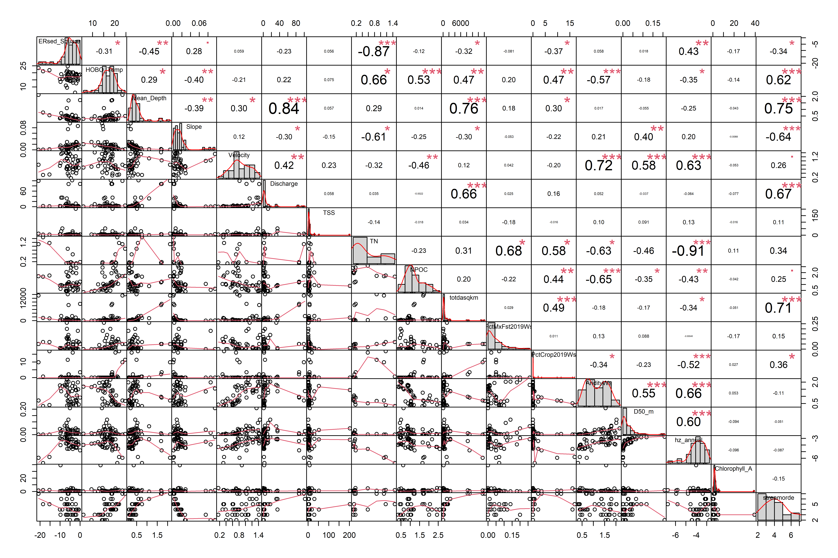
Scatterplot between ERsed and variables

Slide 3
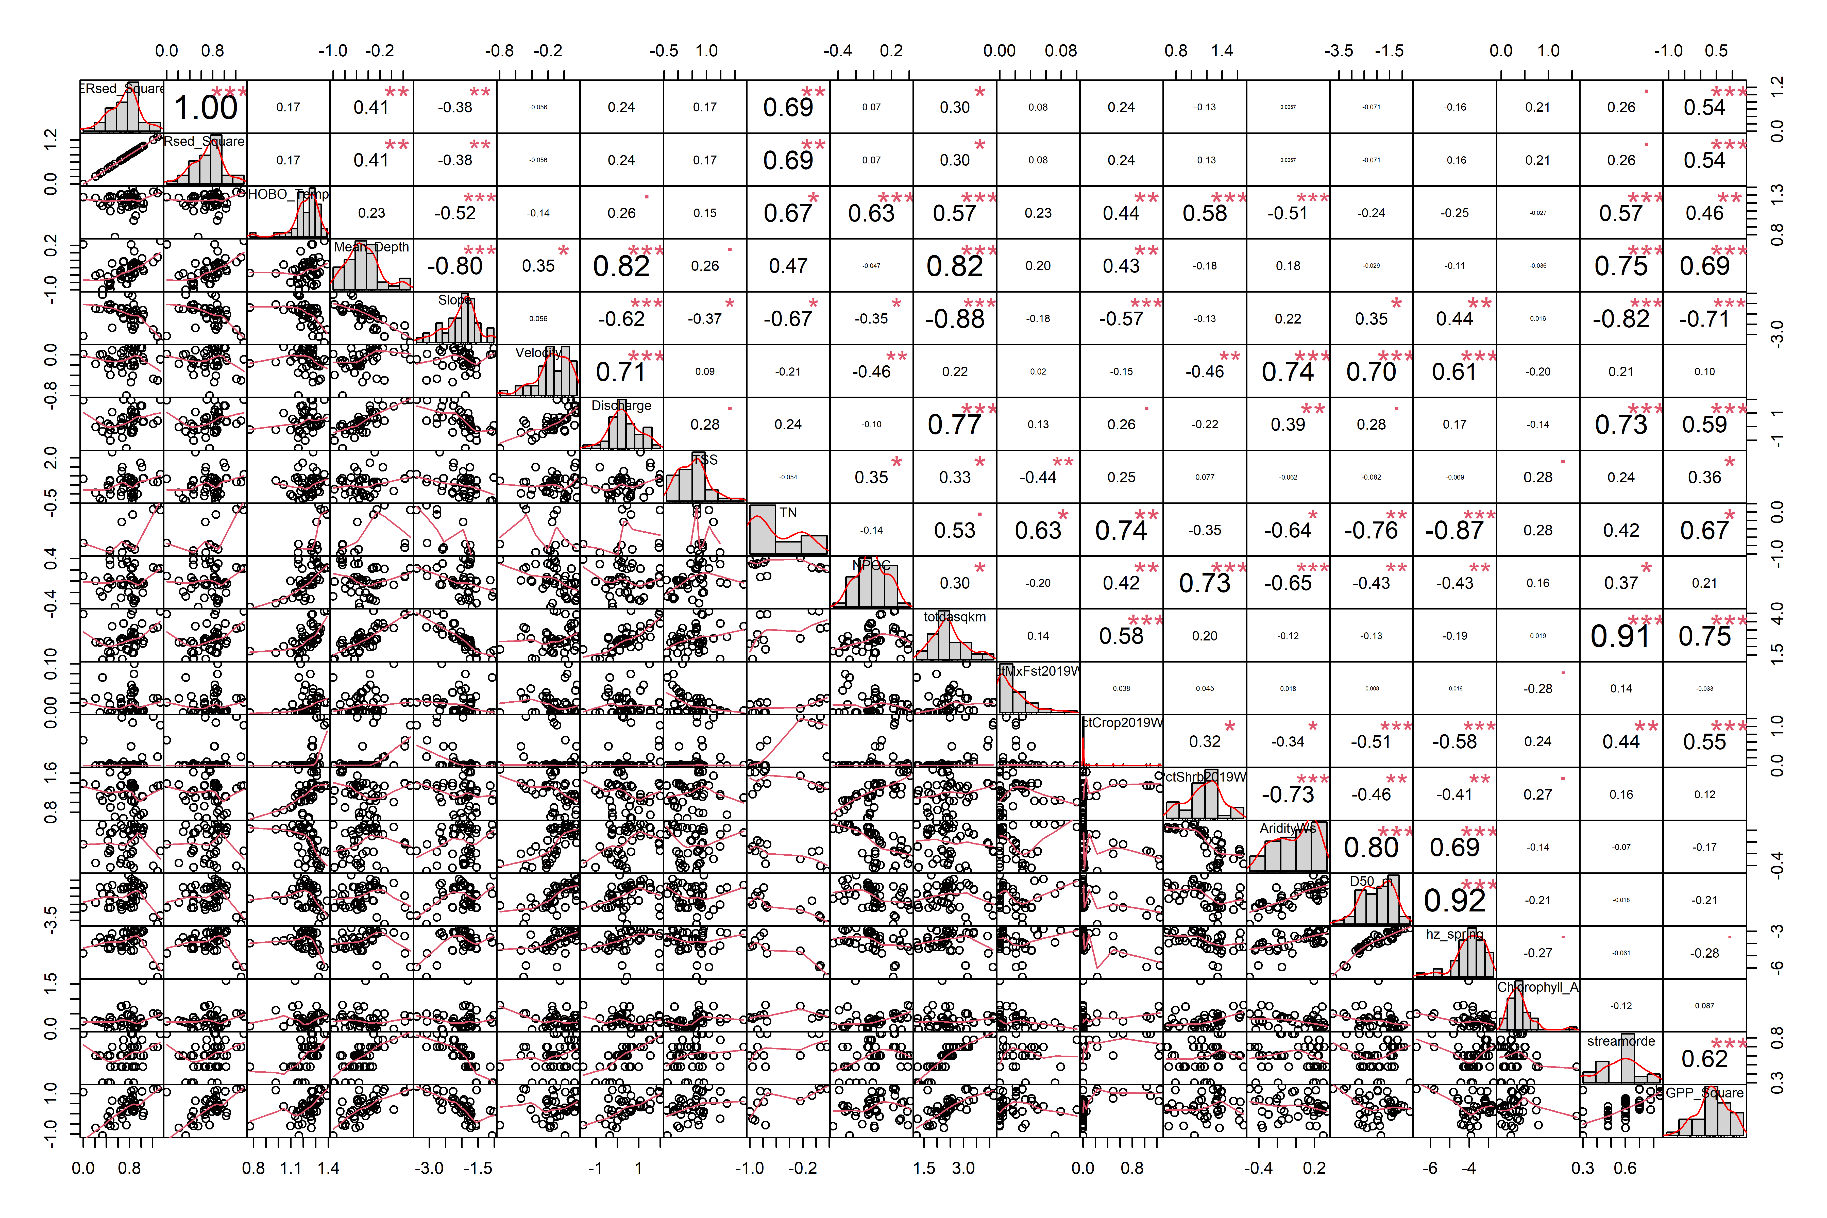
Scatterplot between ERsed and variables (log transform for all variables)

Slide 4
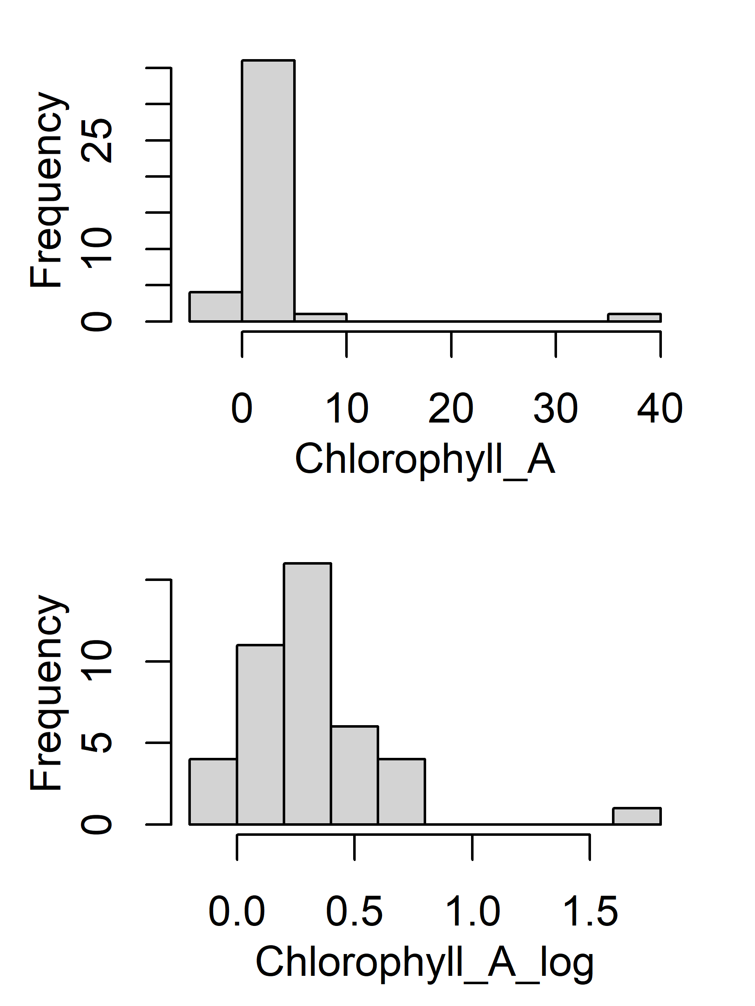
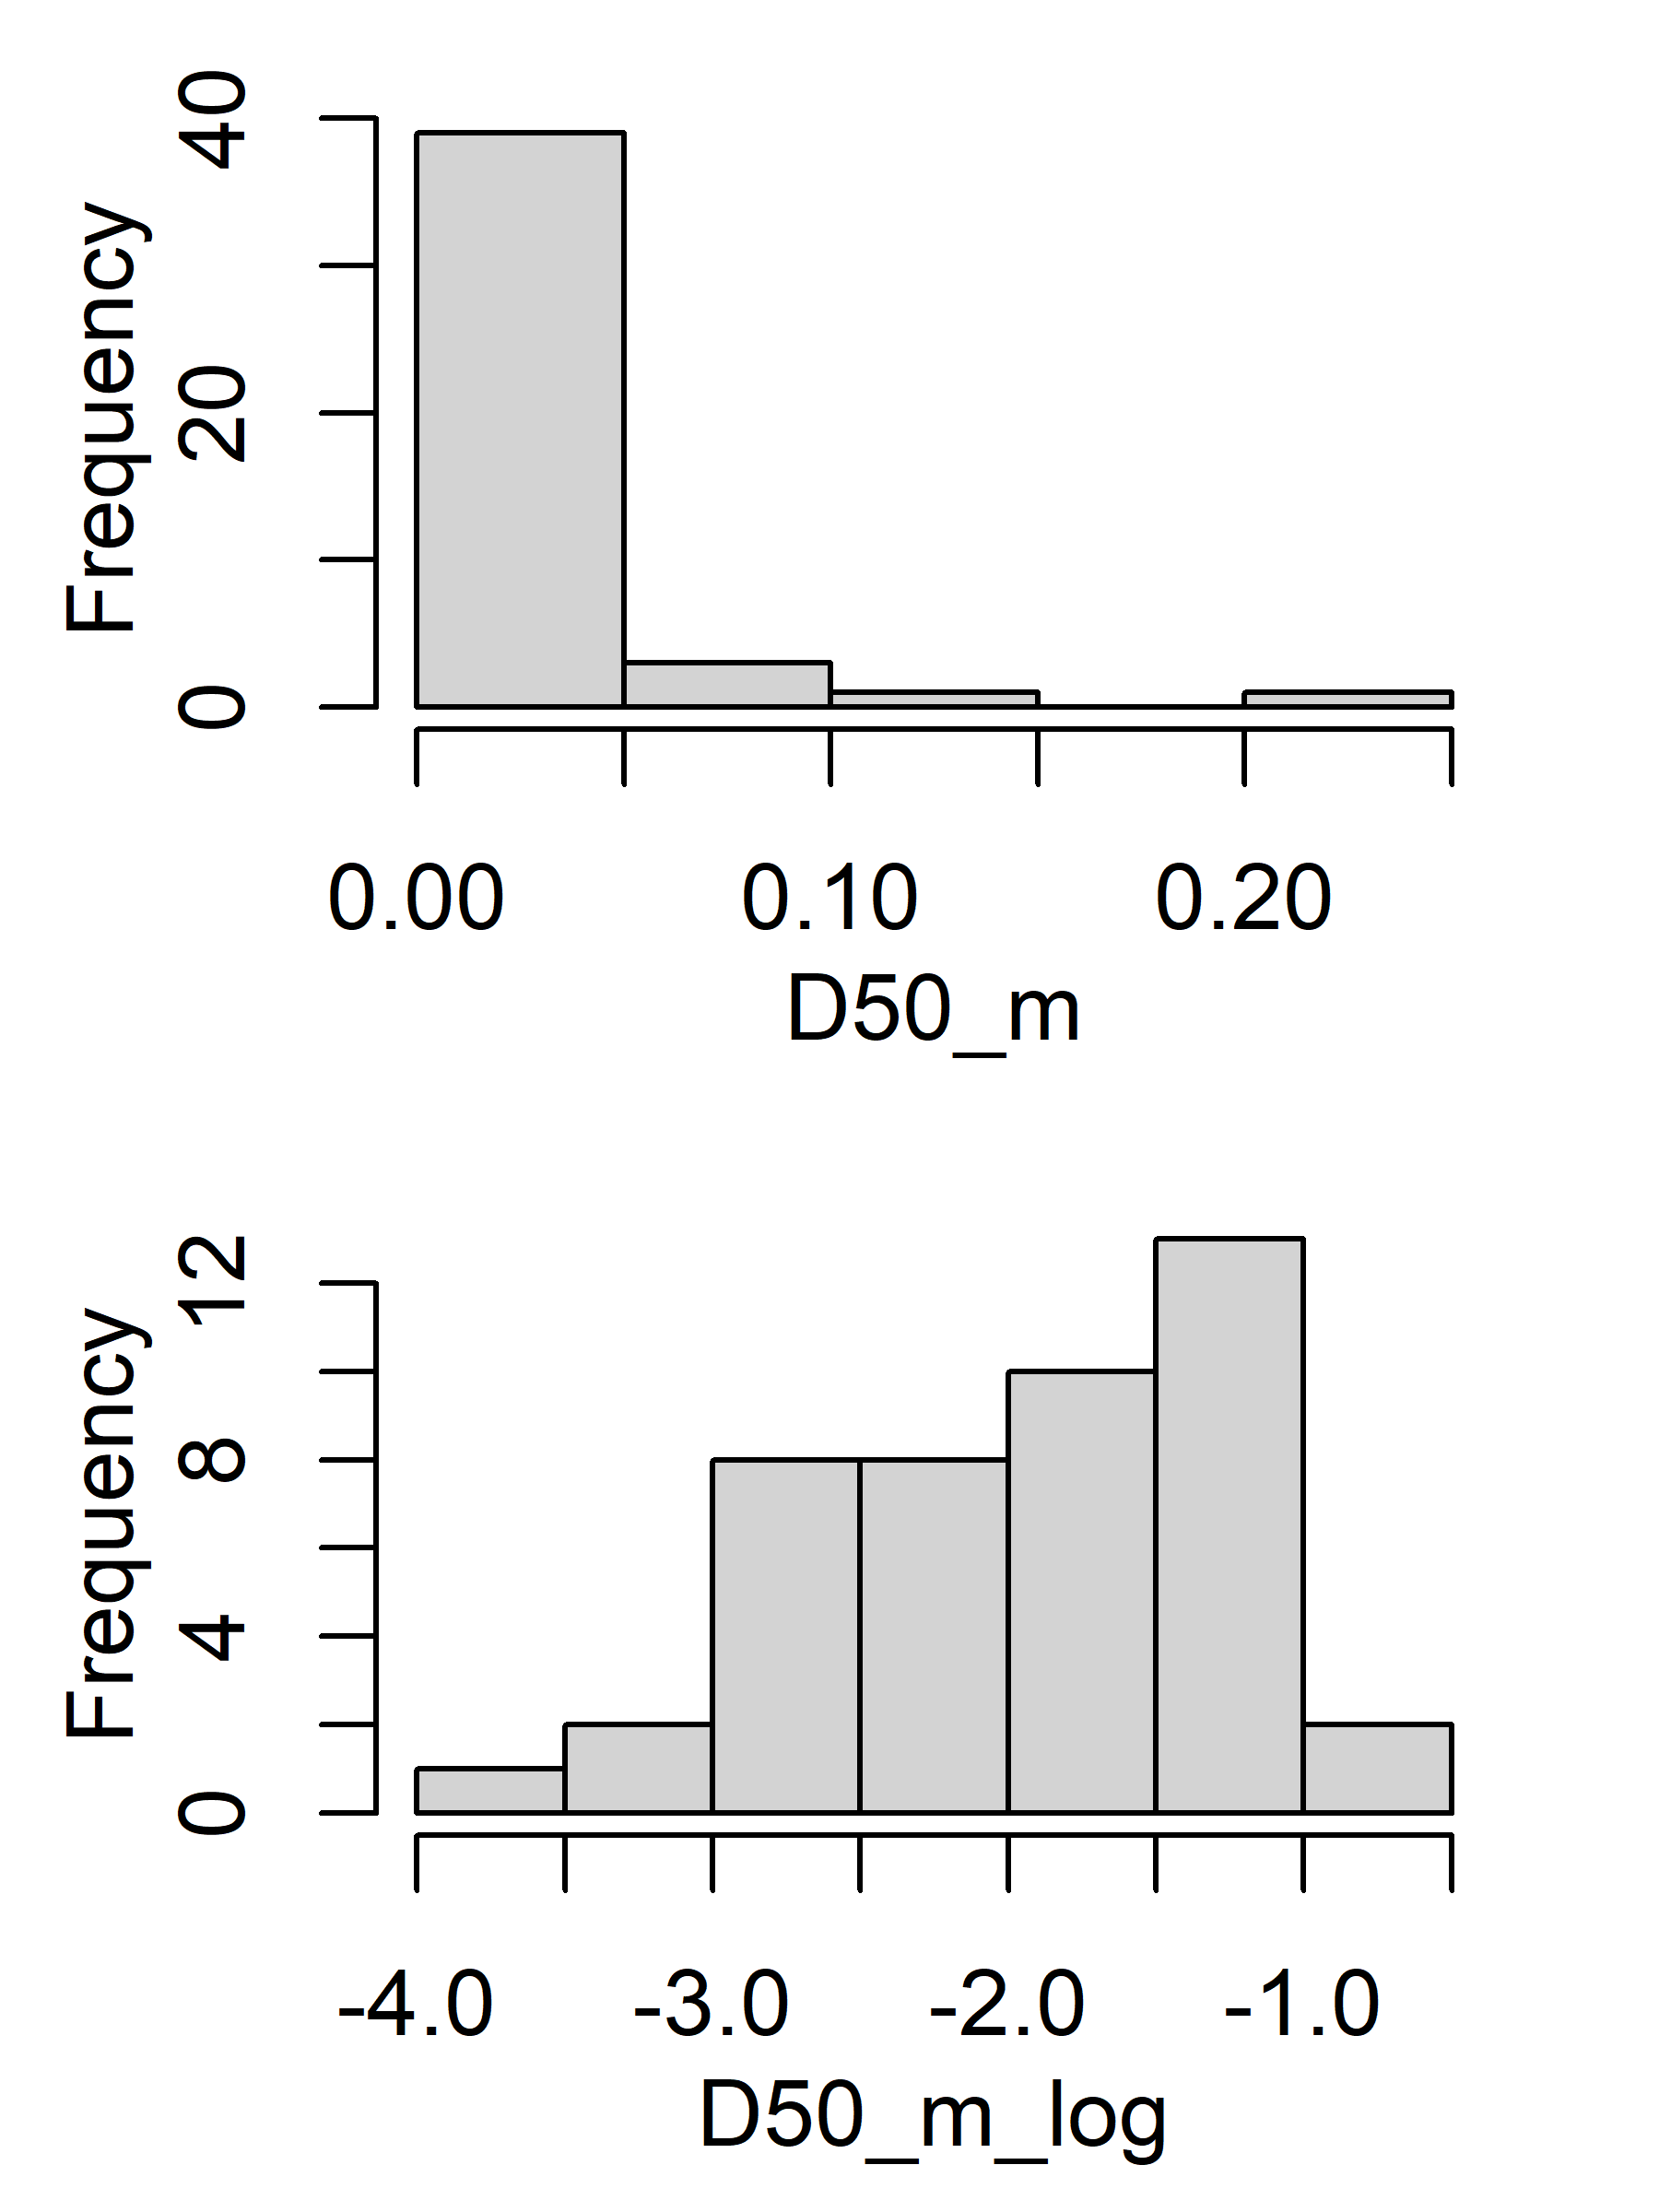
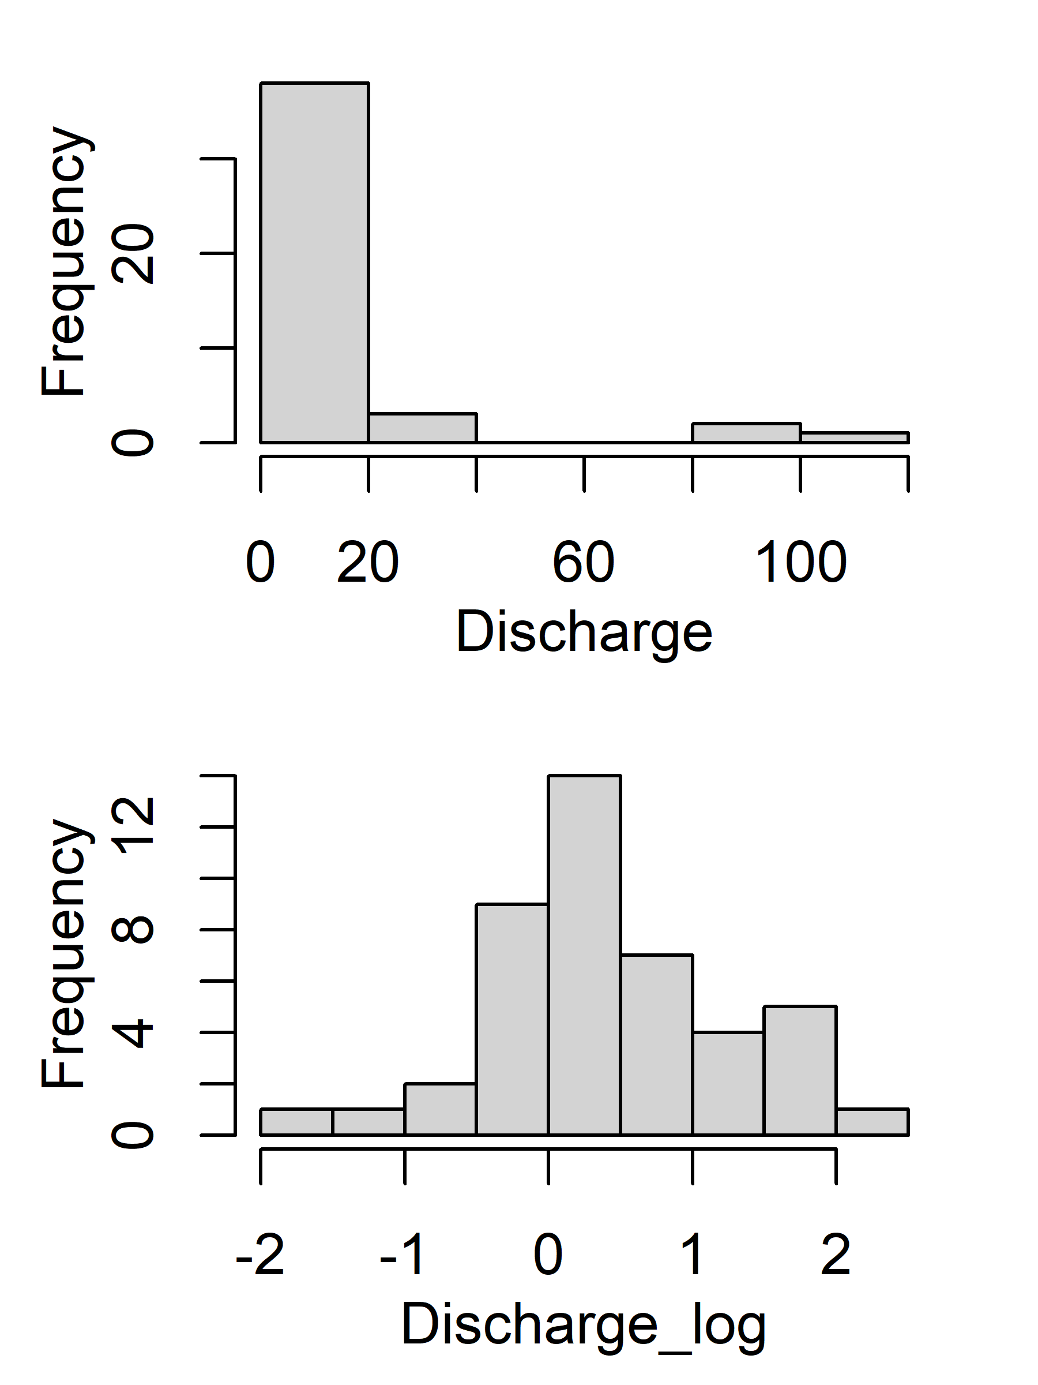
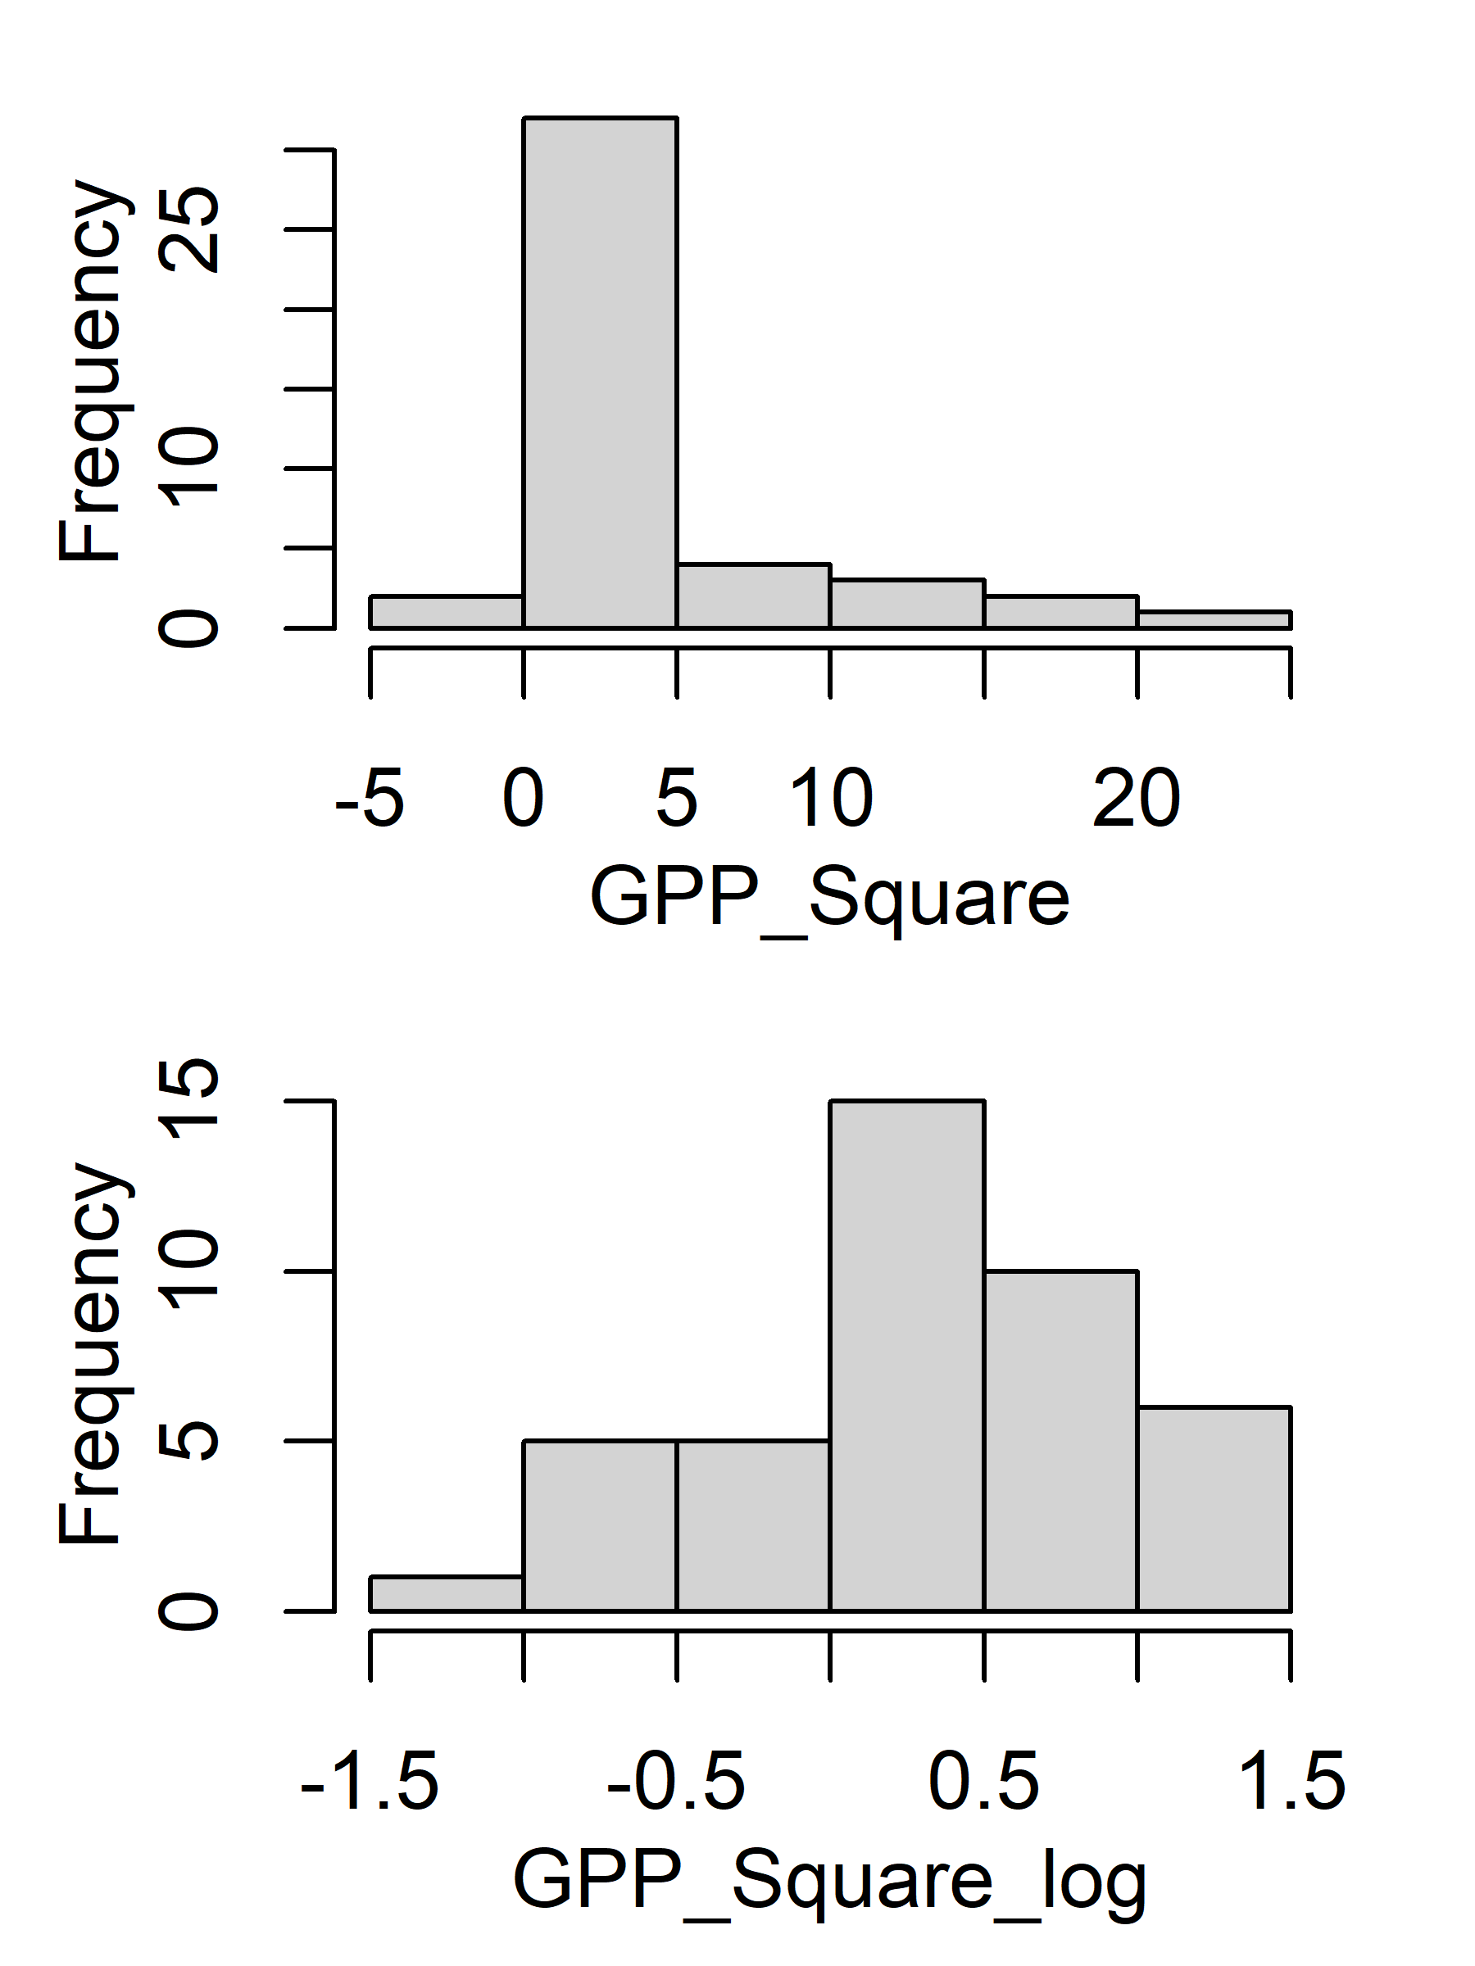
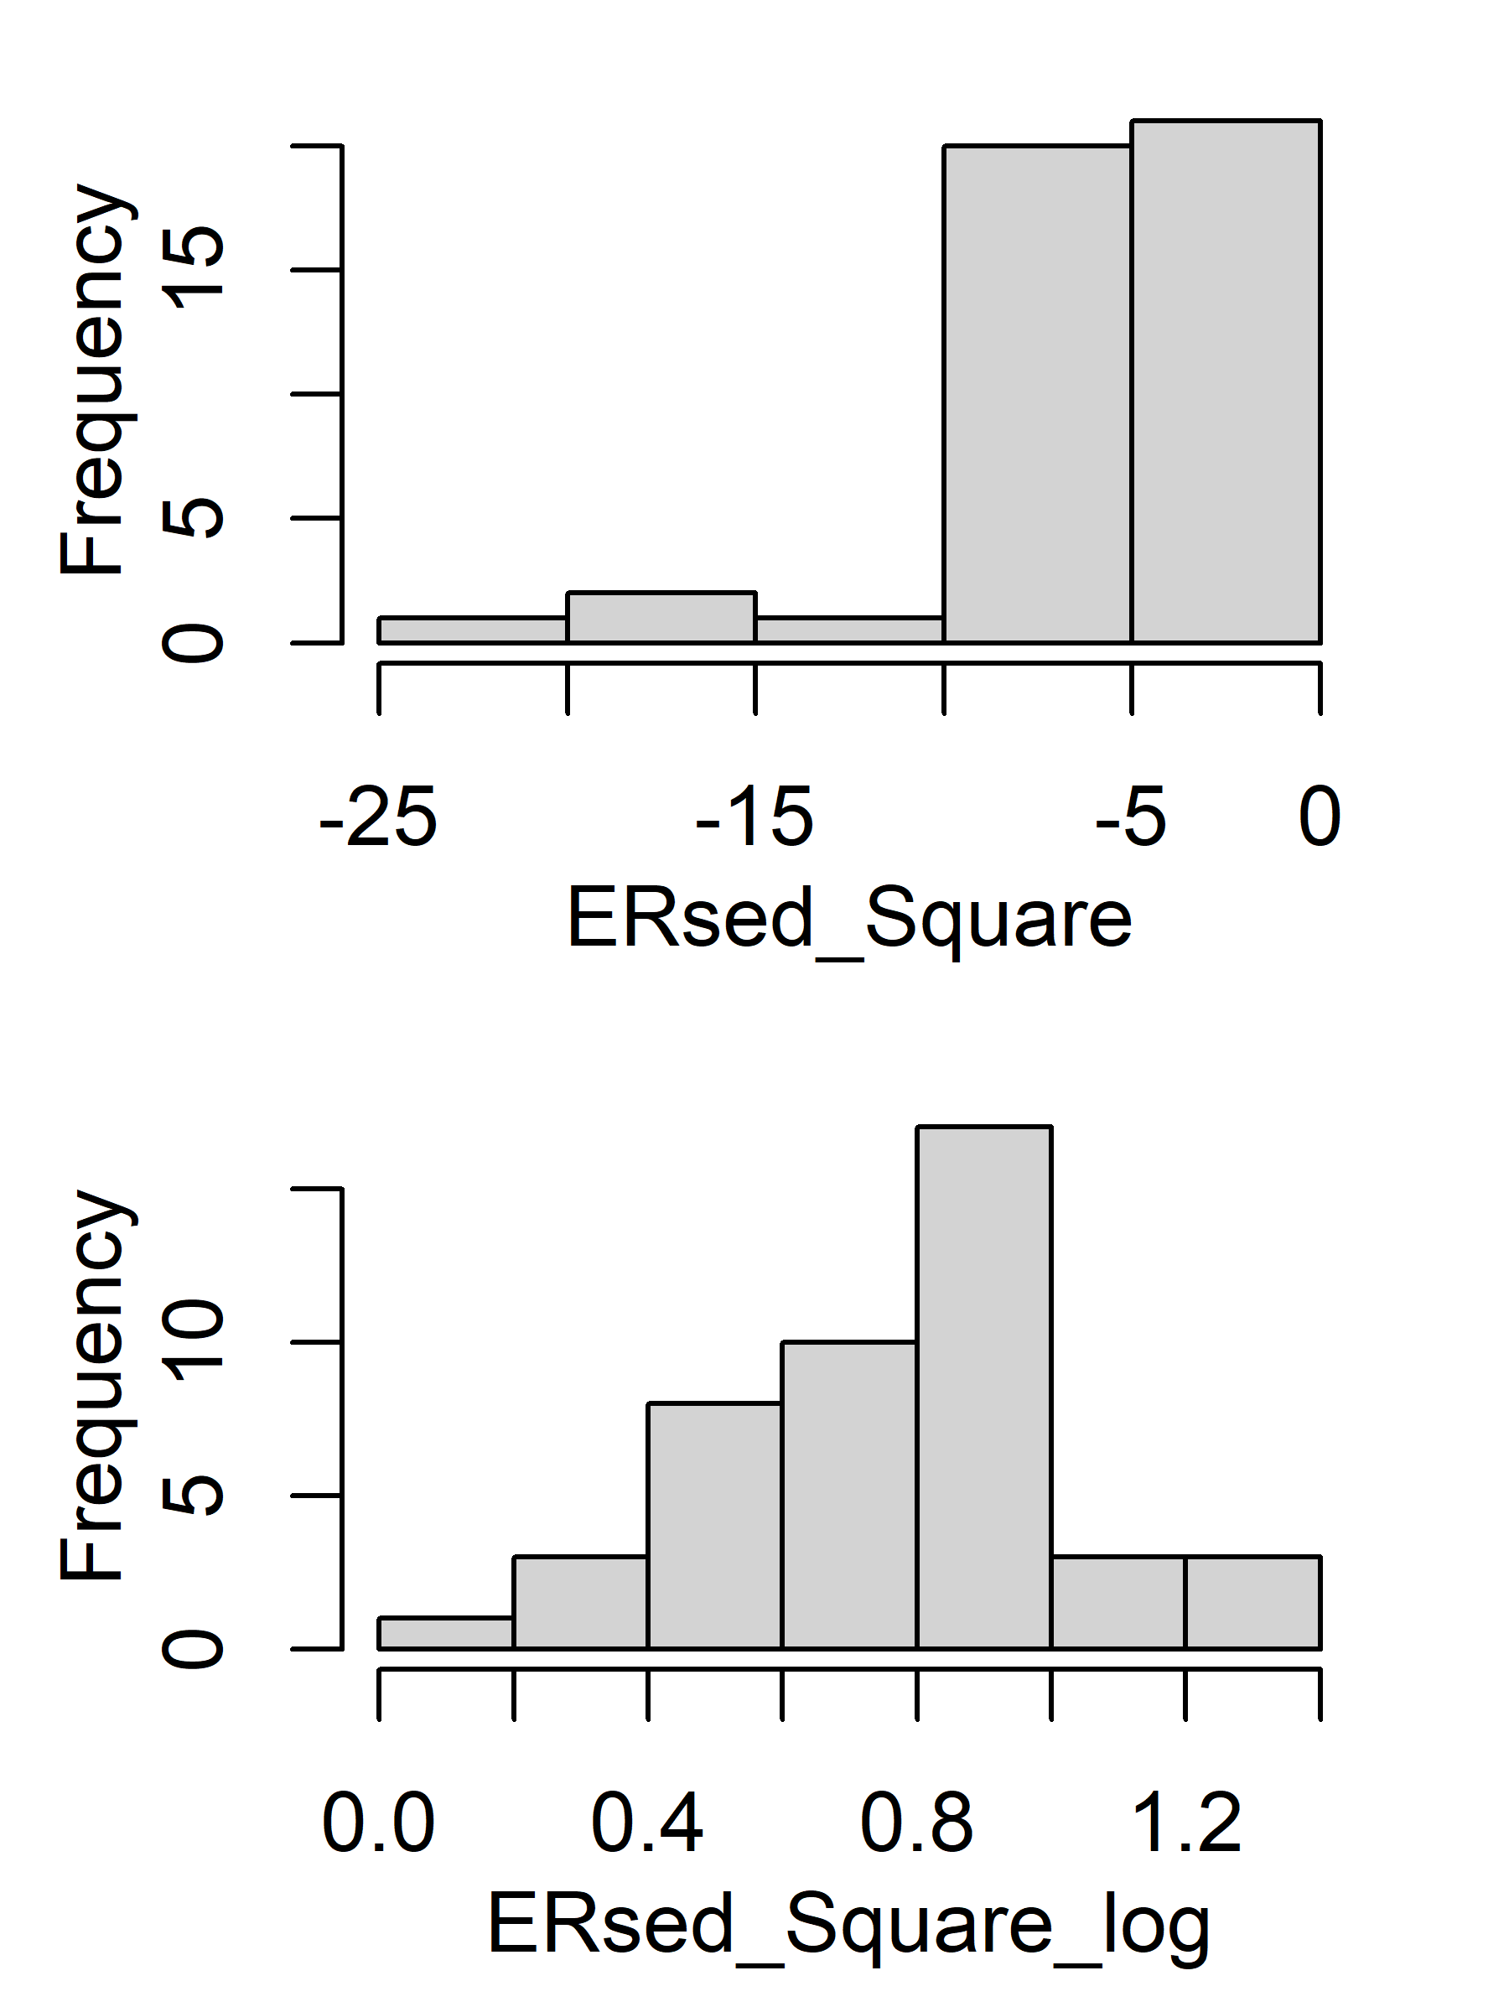
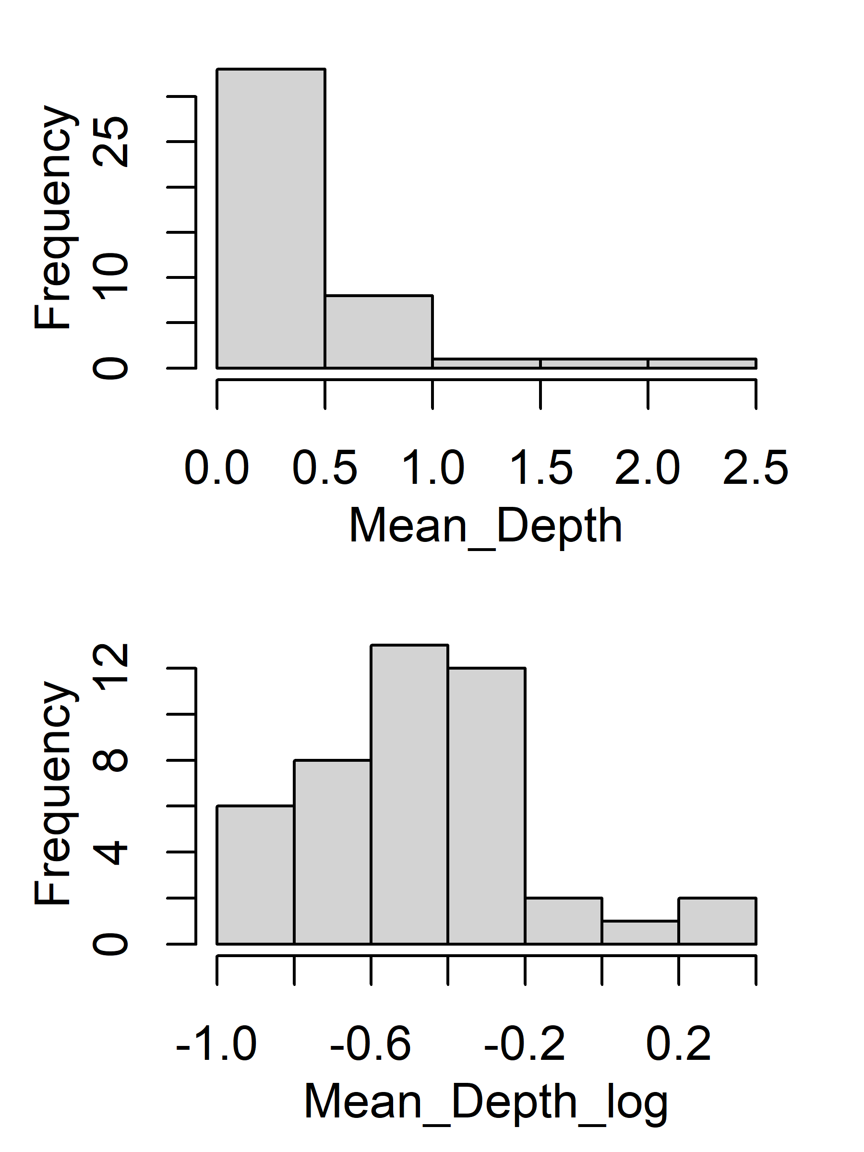
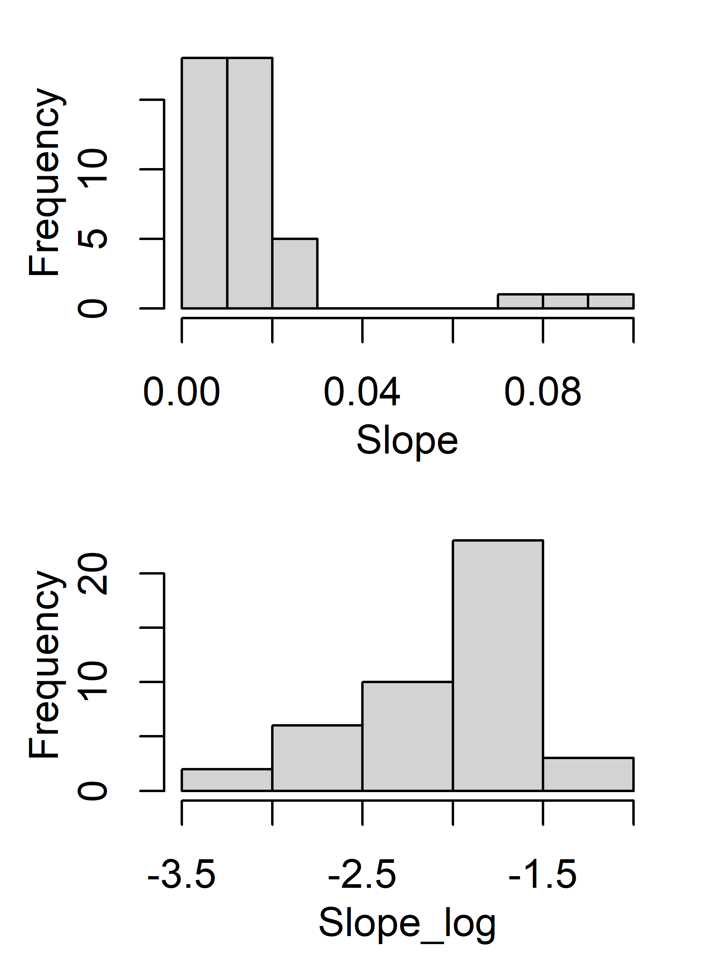
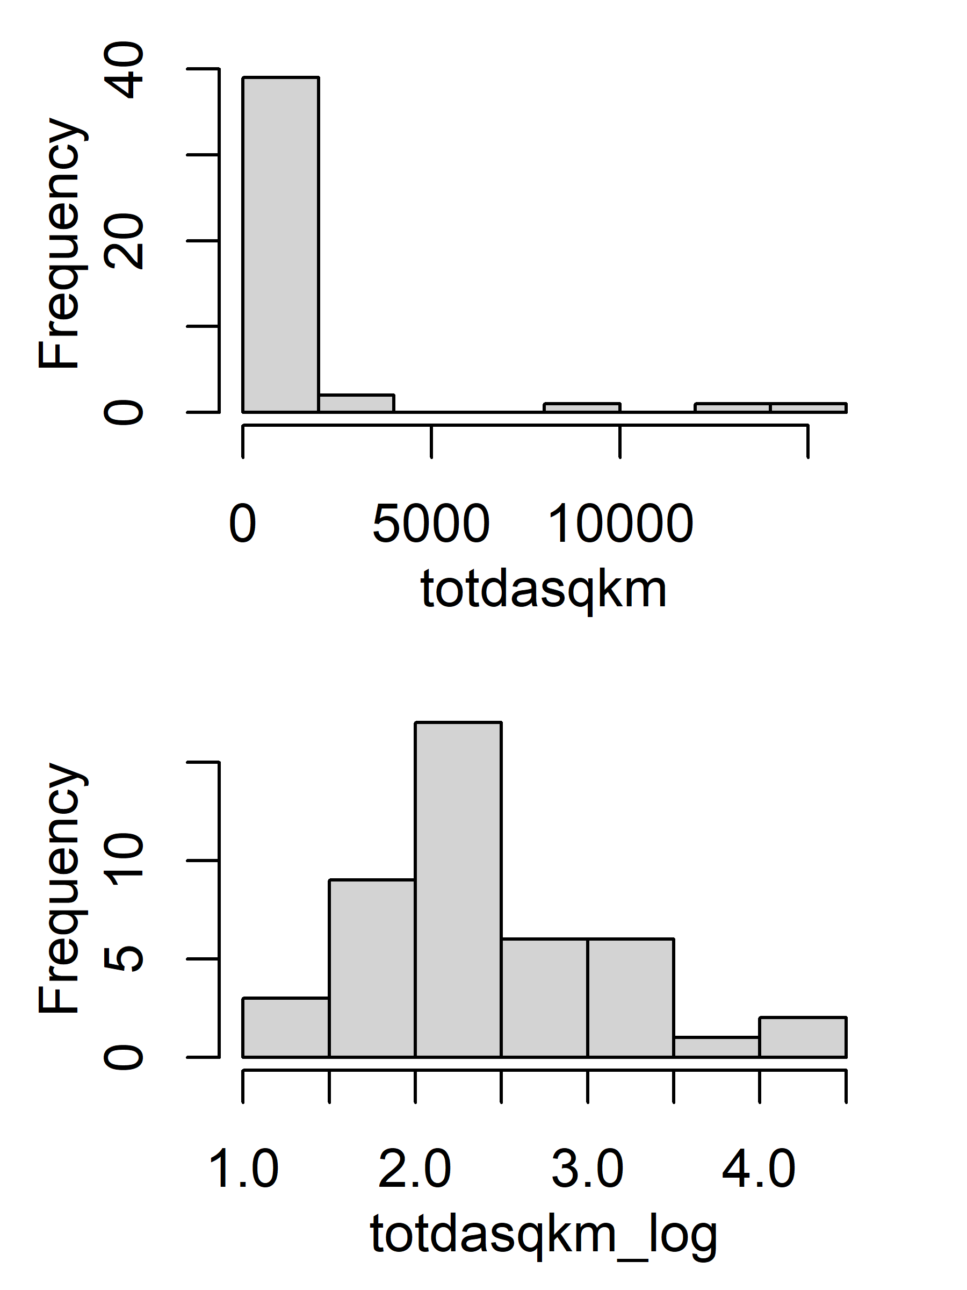
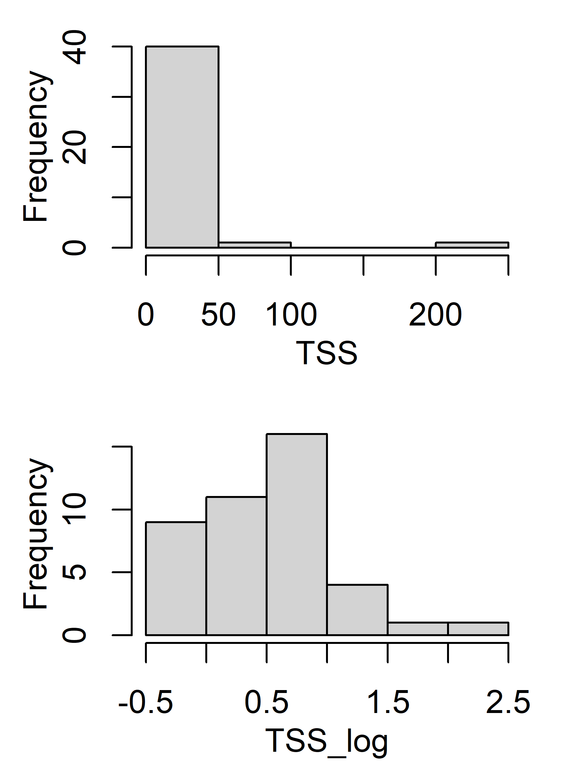
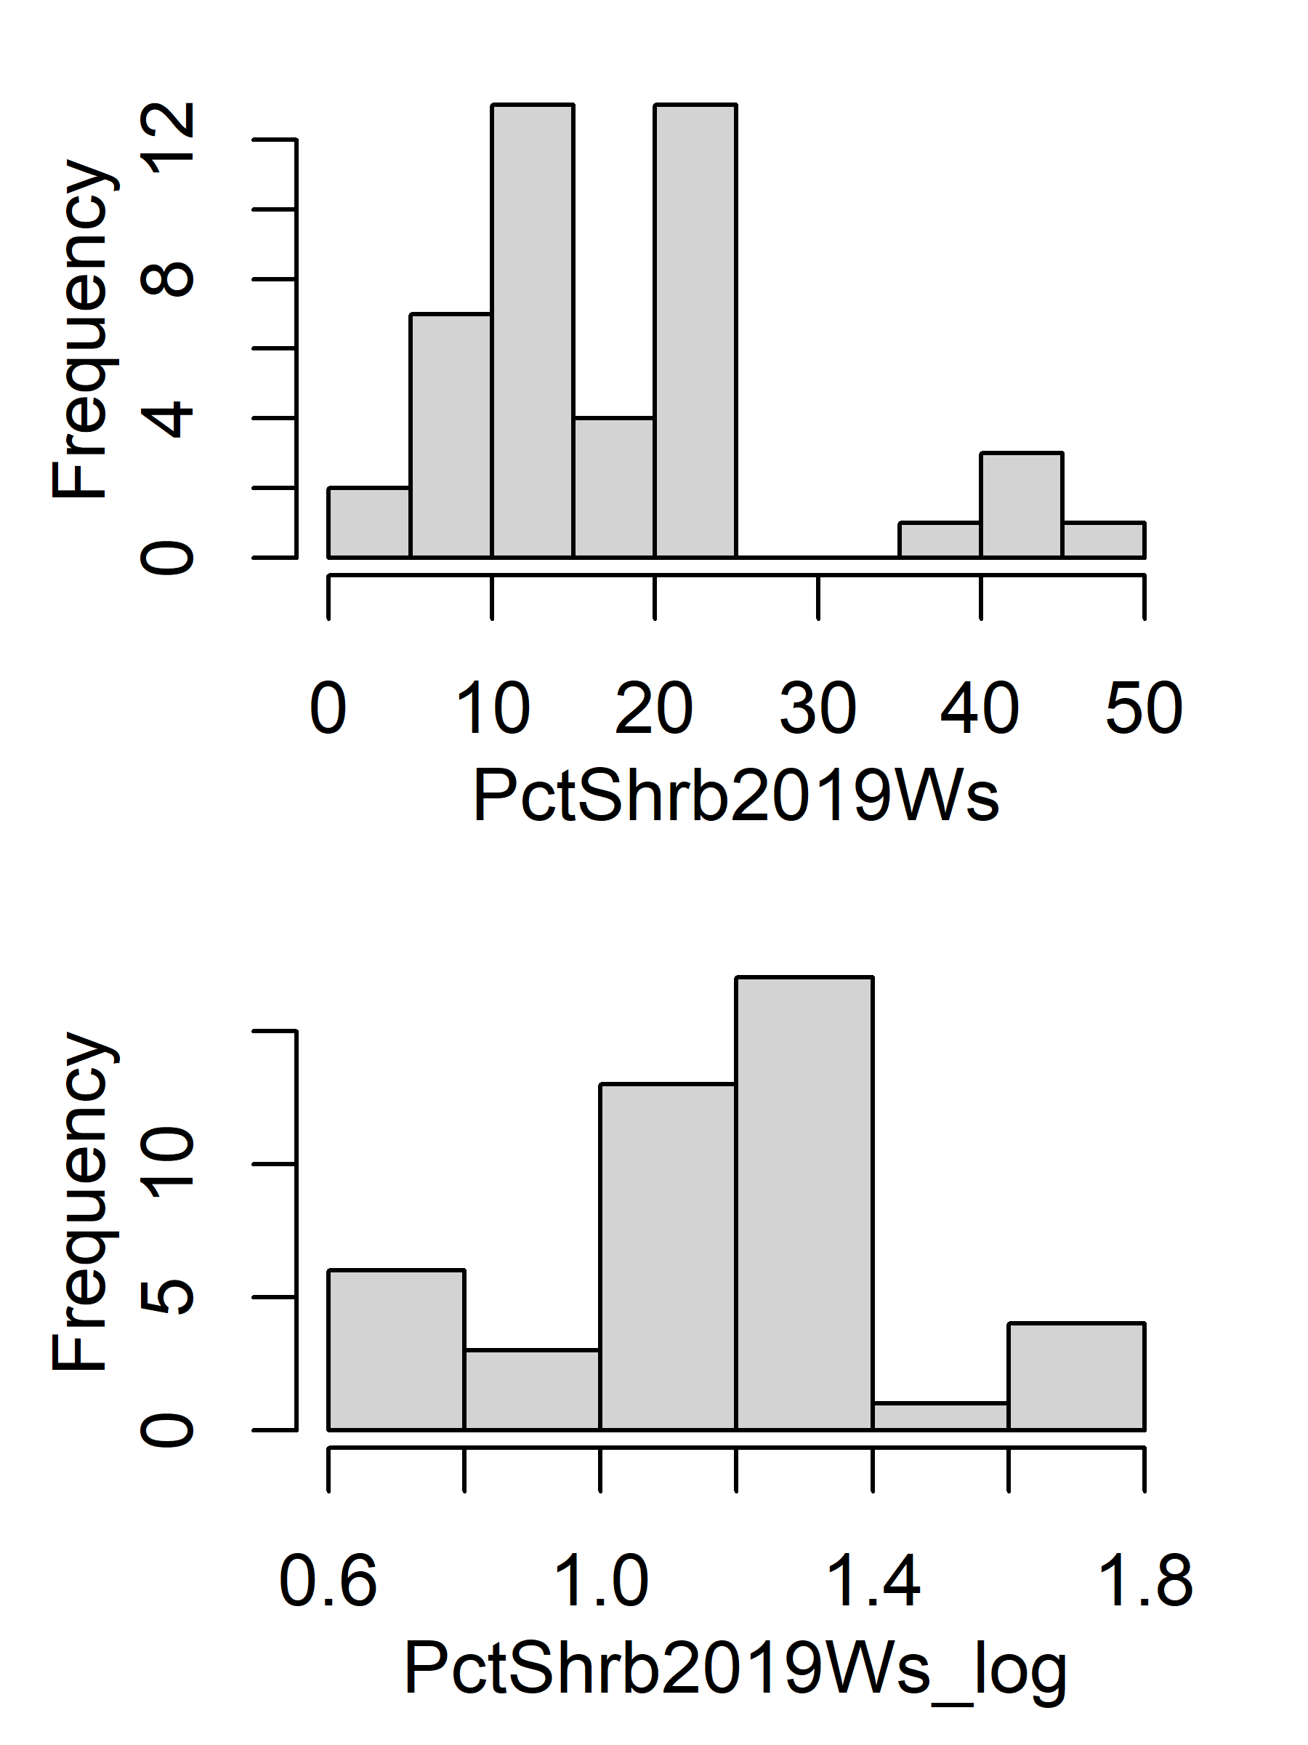
Histogram (original vs log)

Slide 5
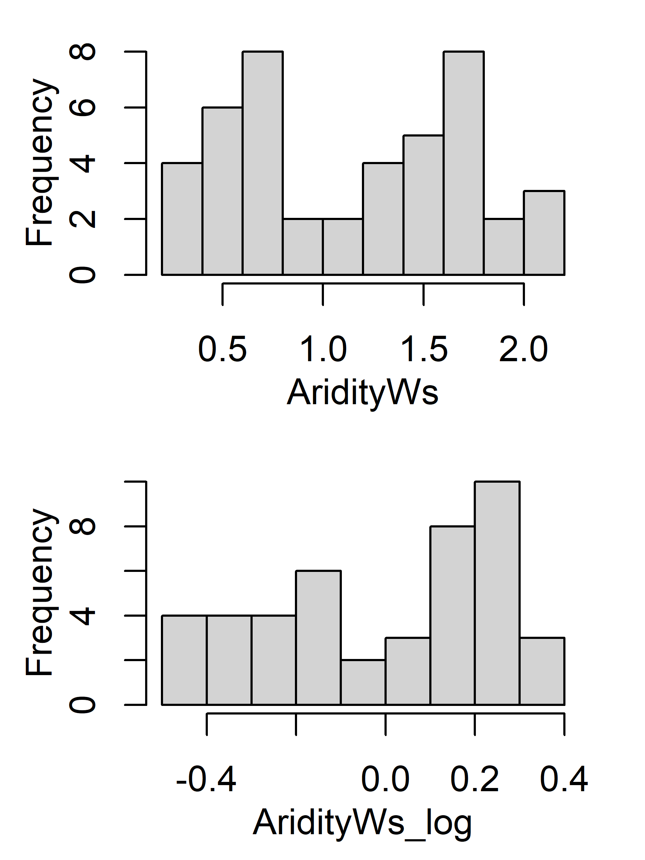
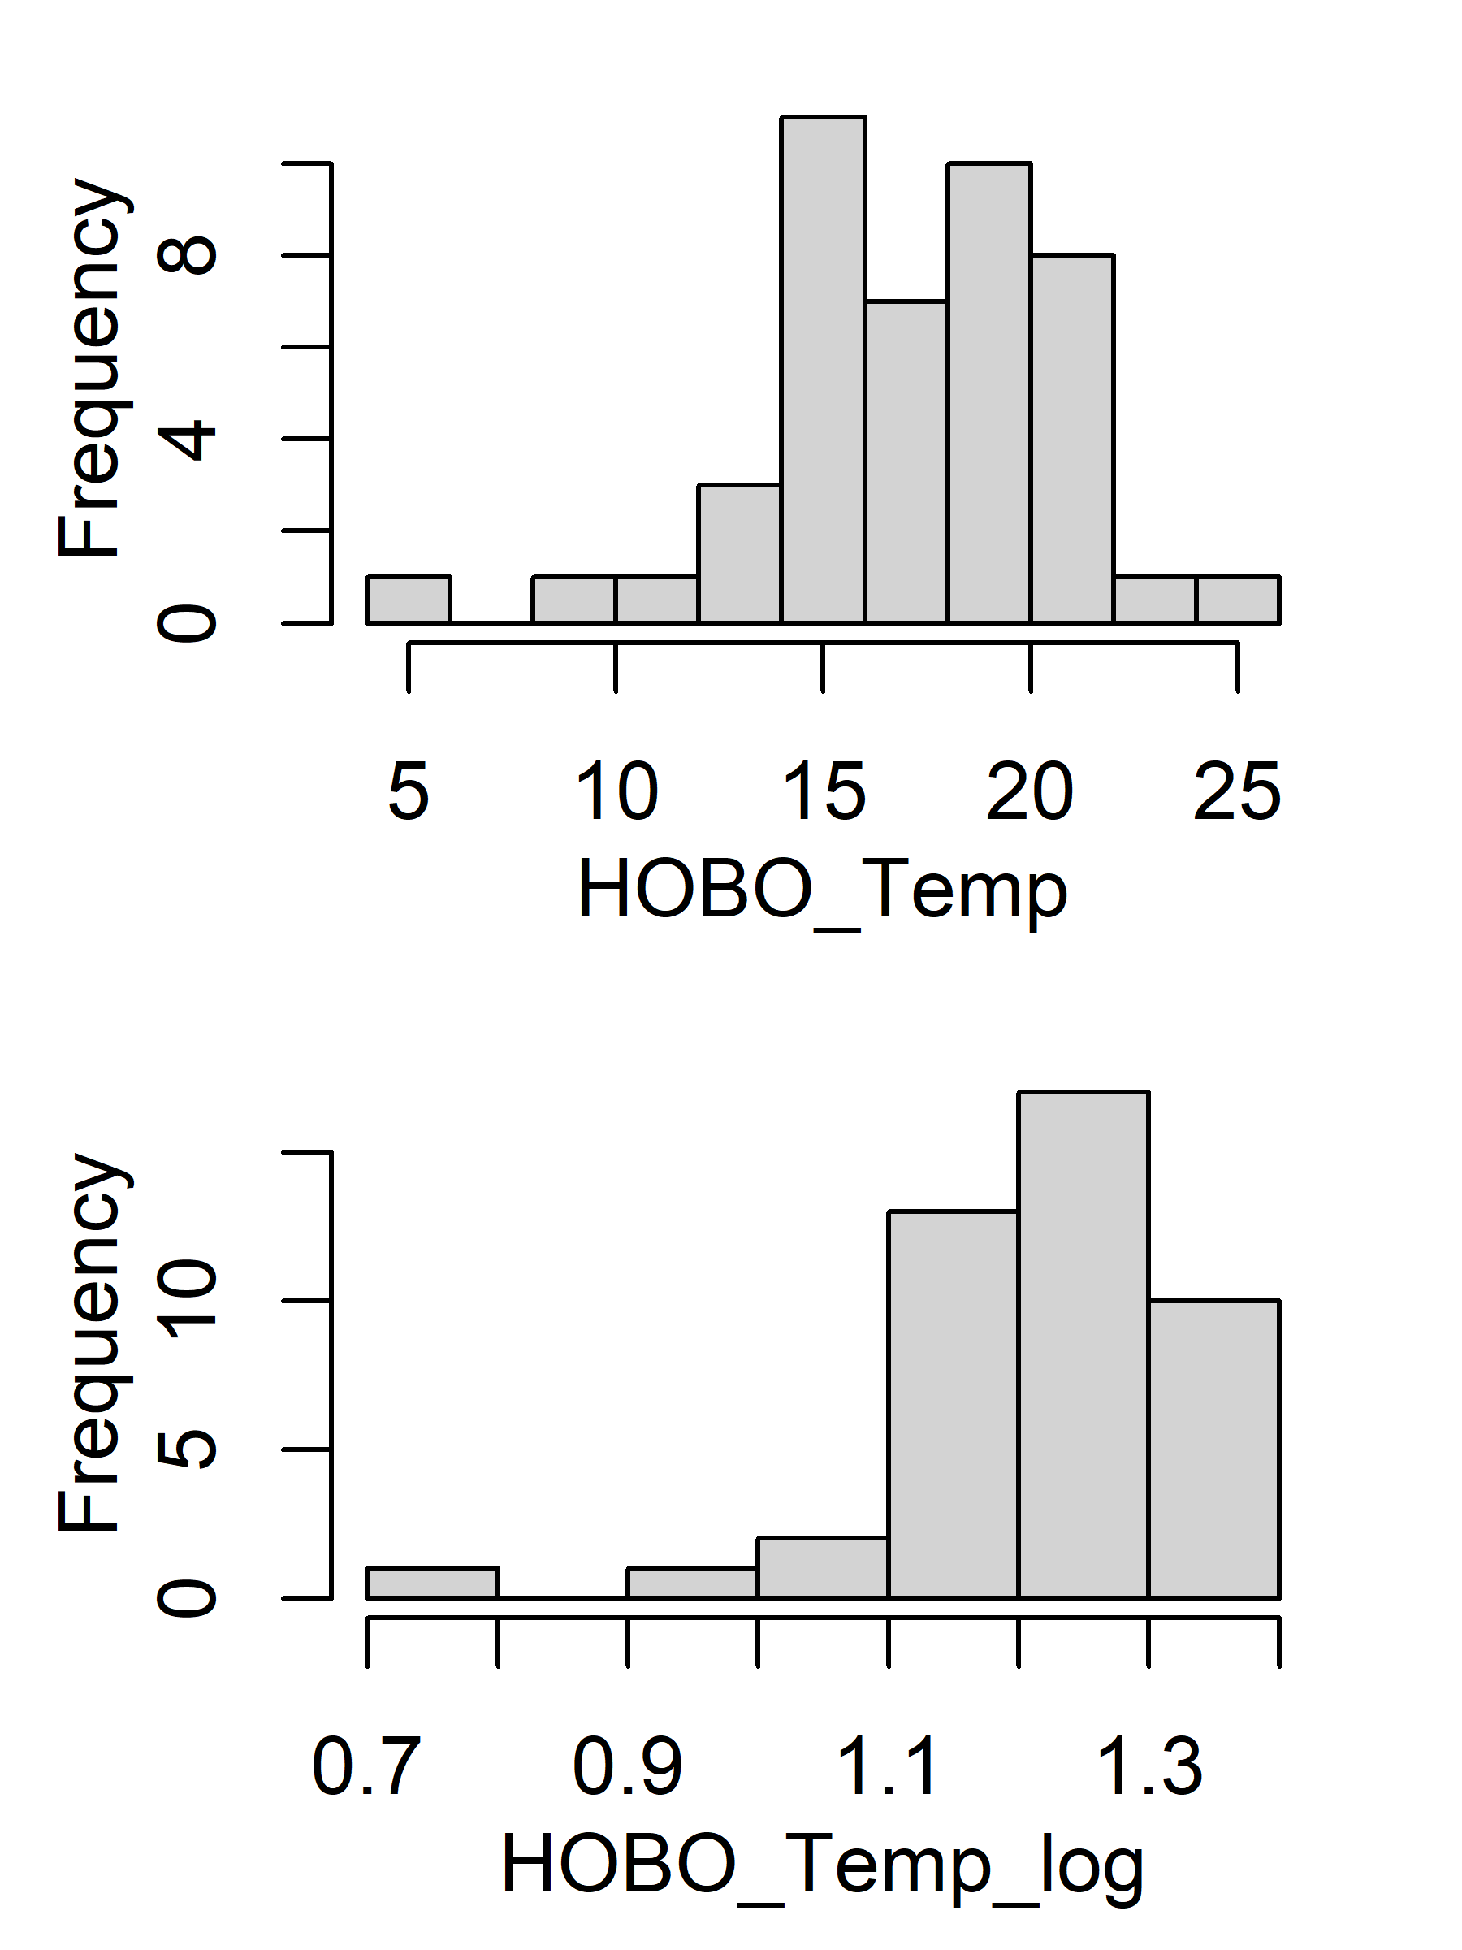
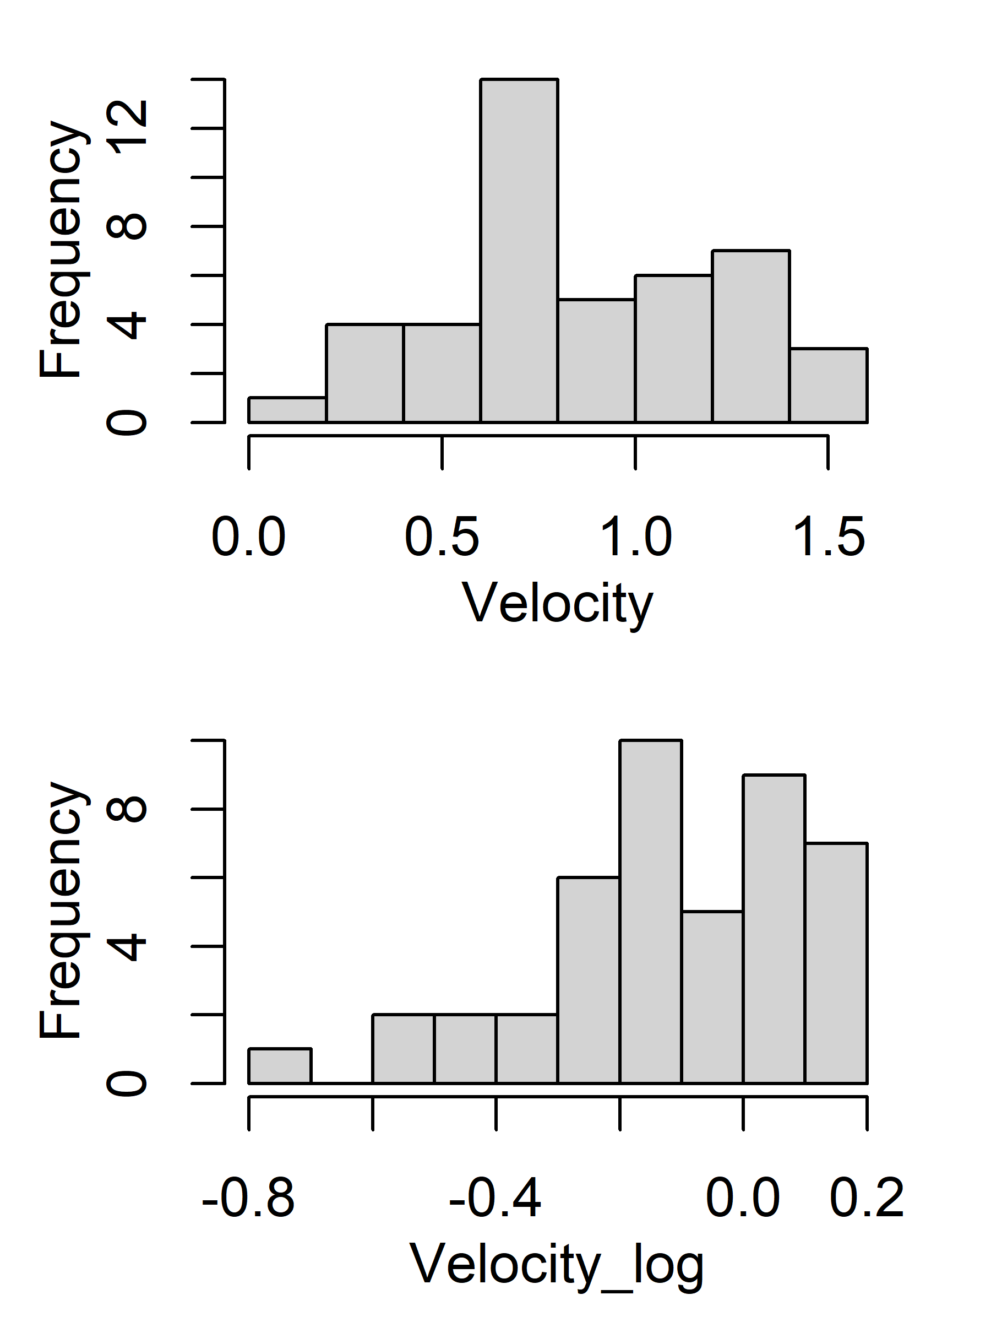
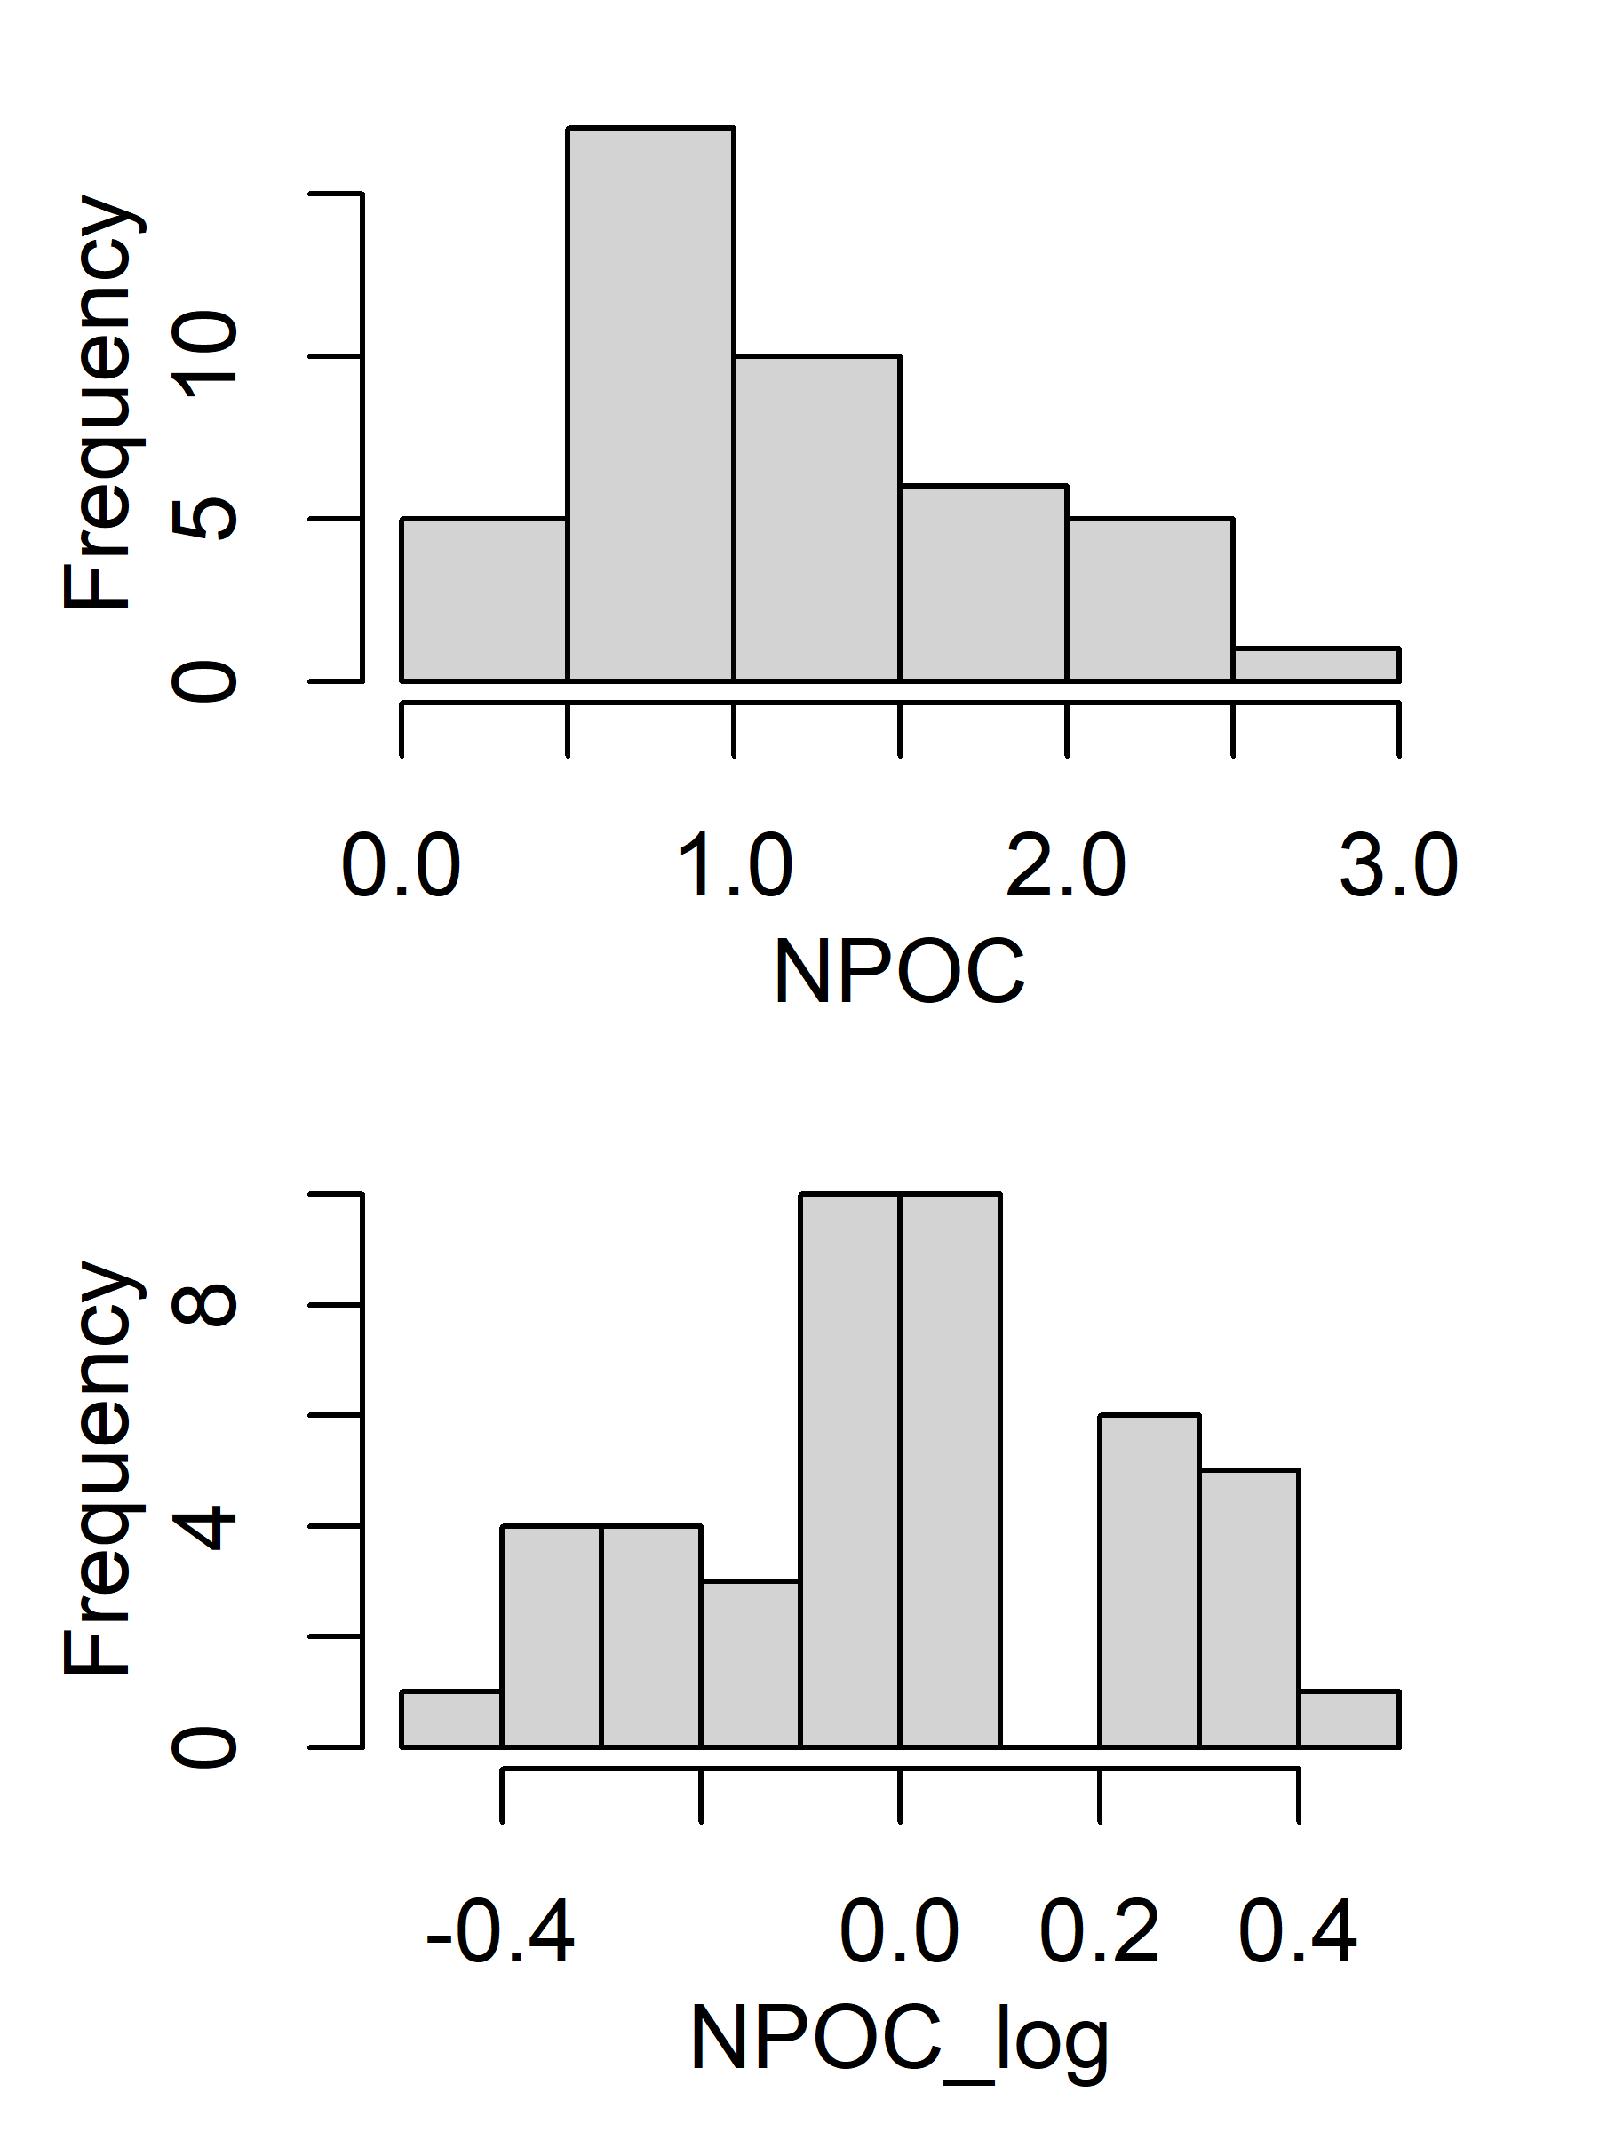
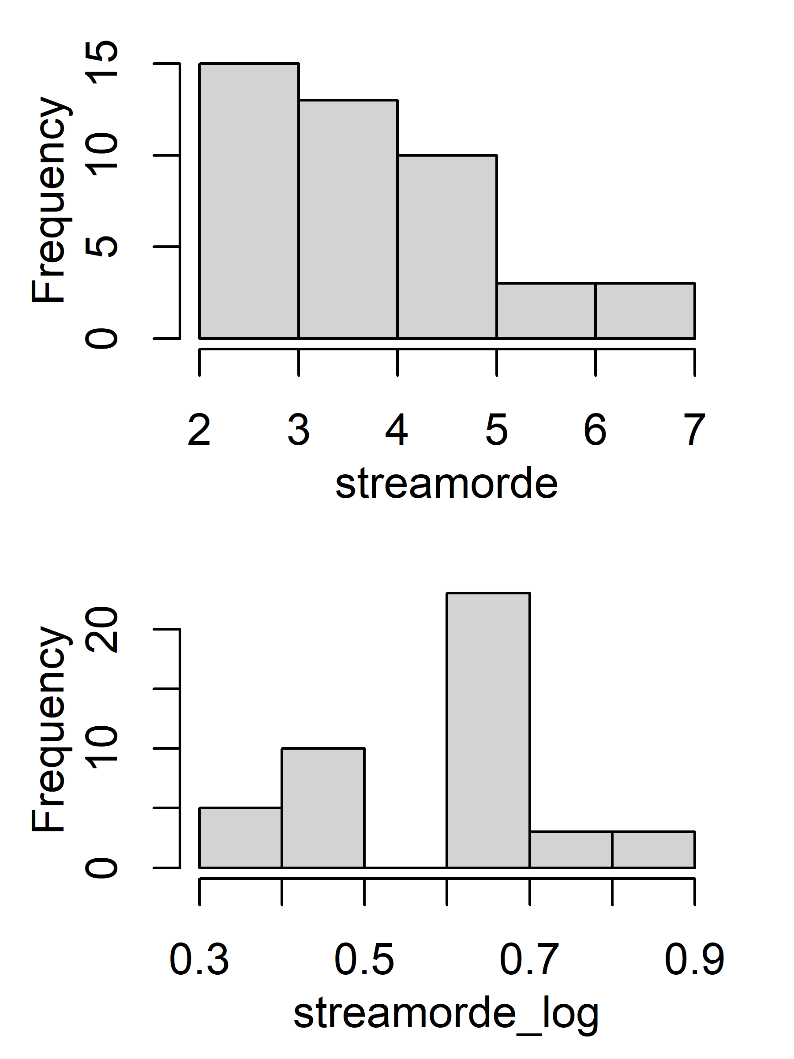
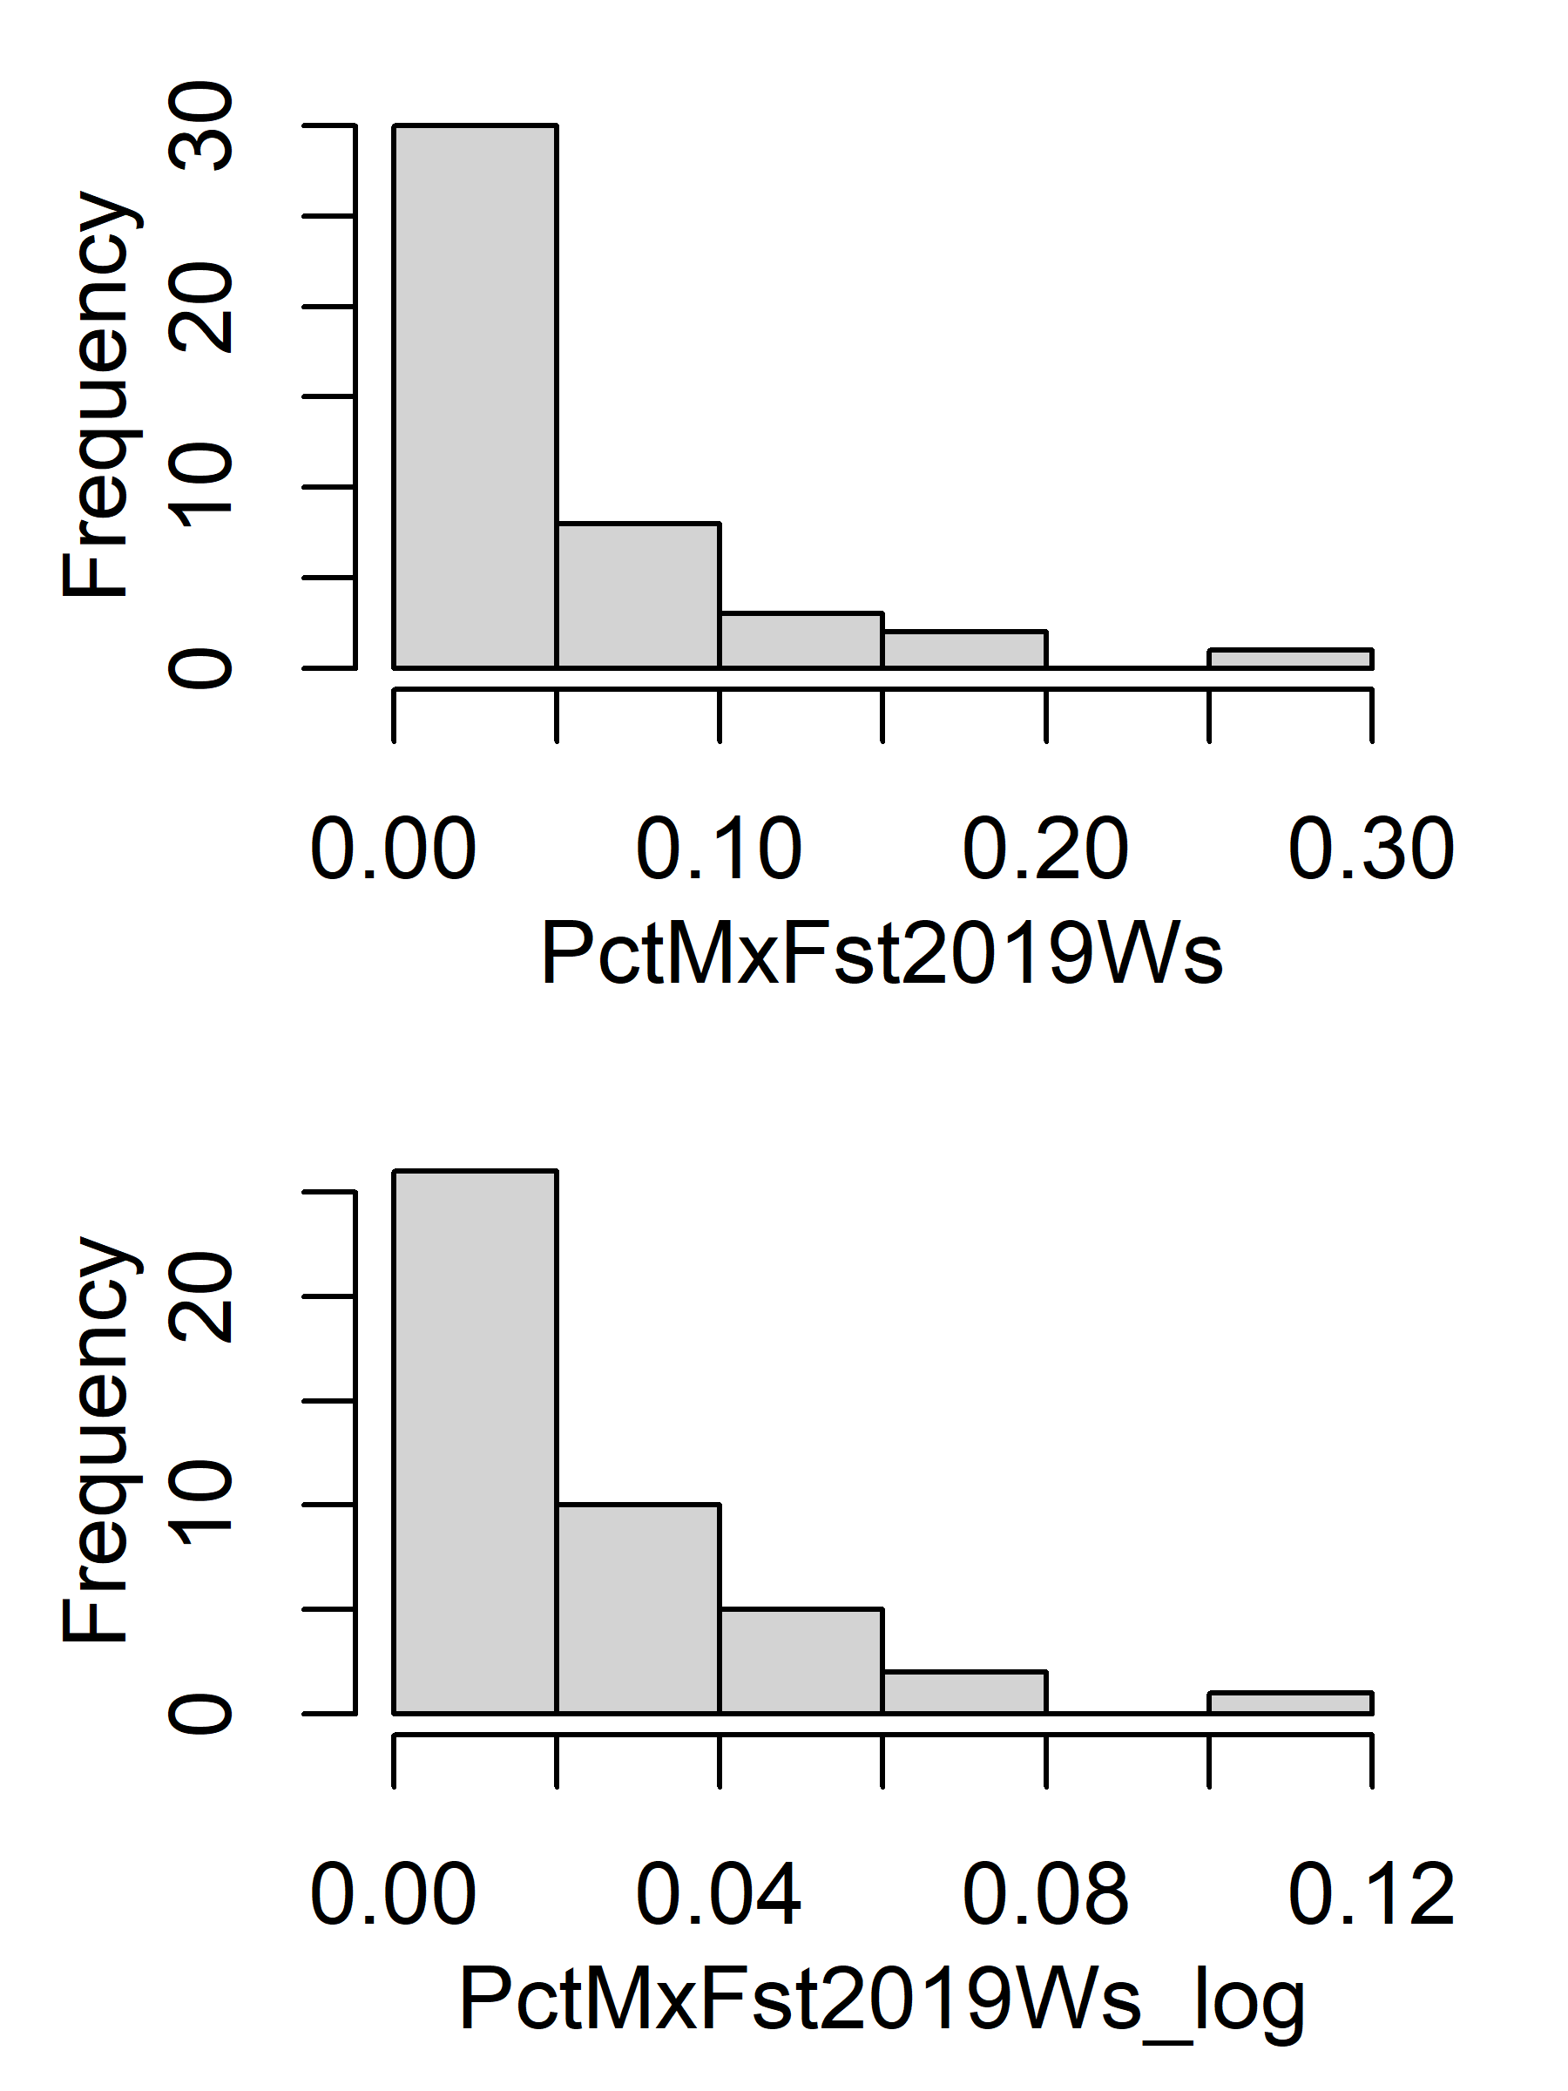
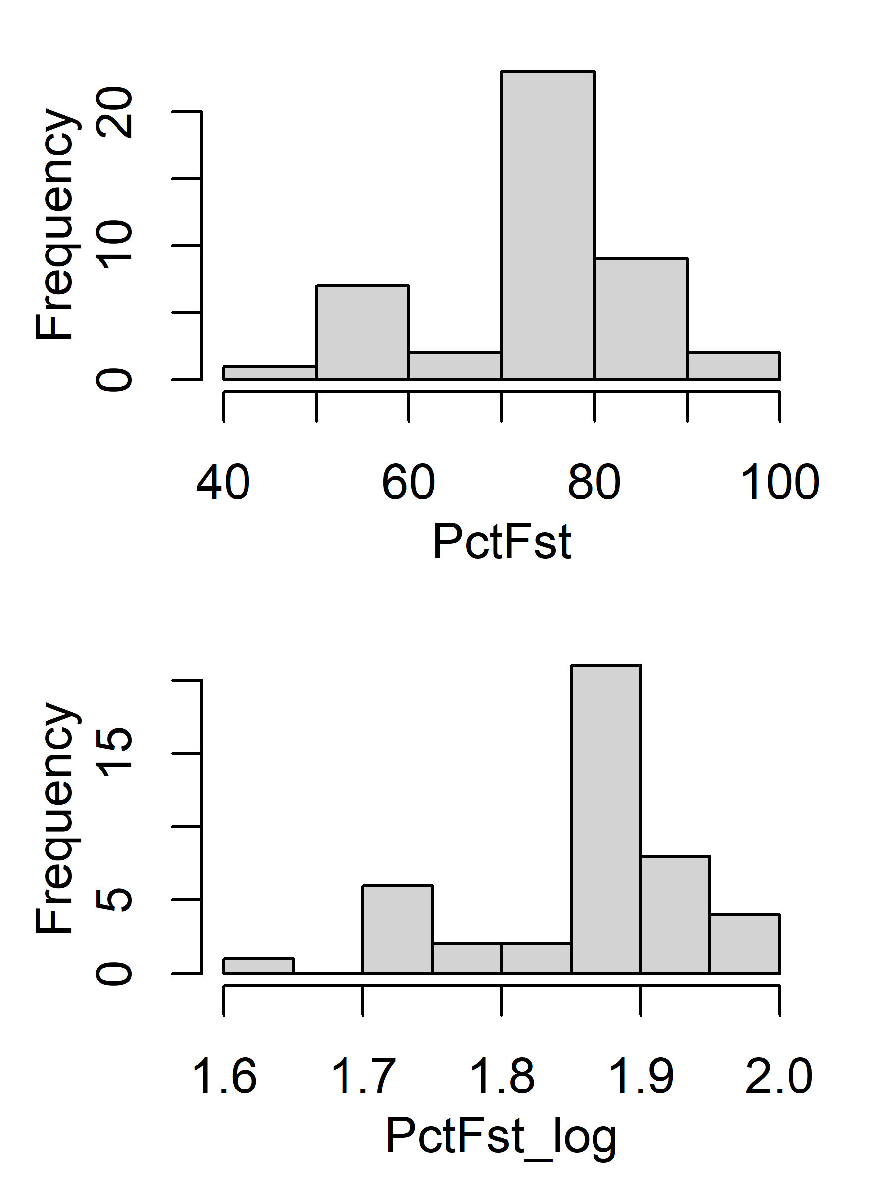
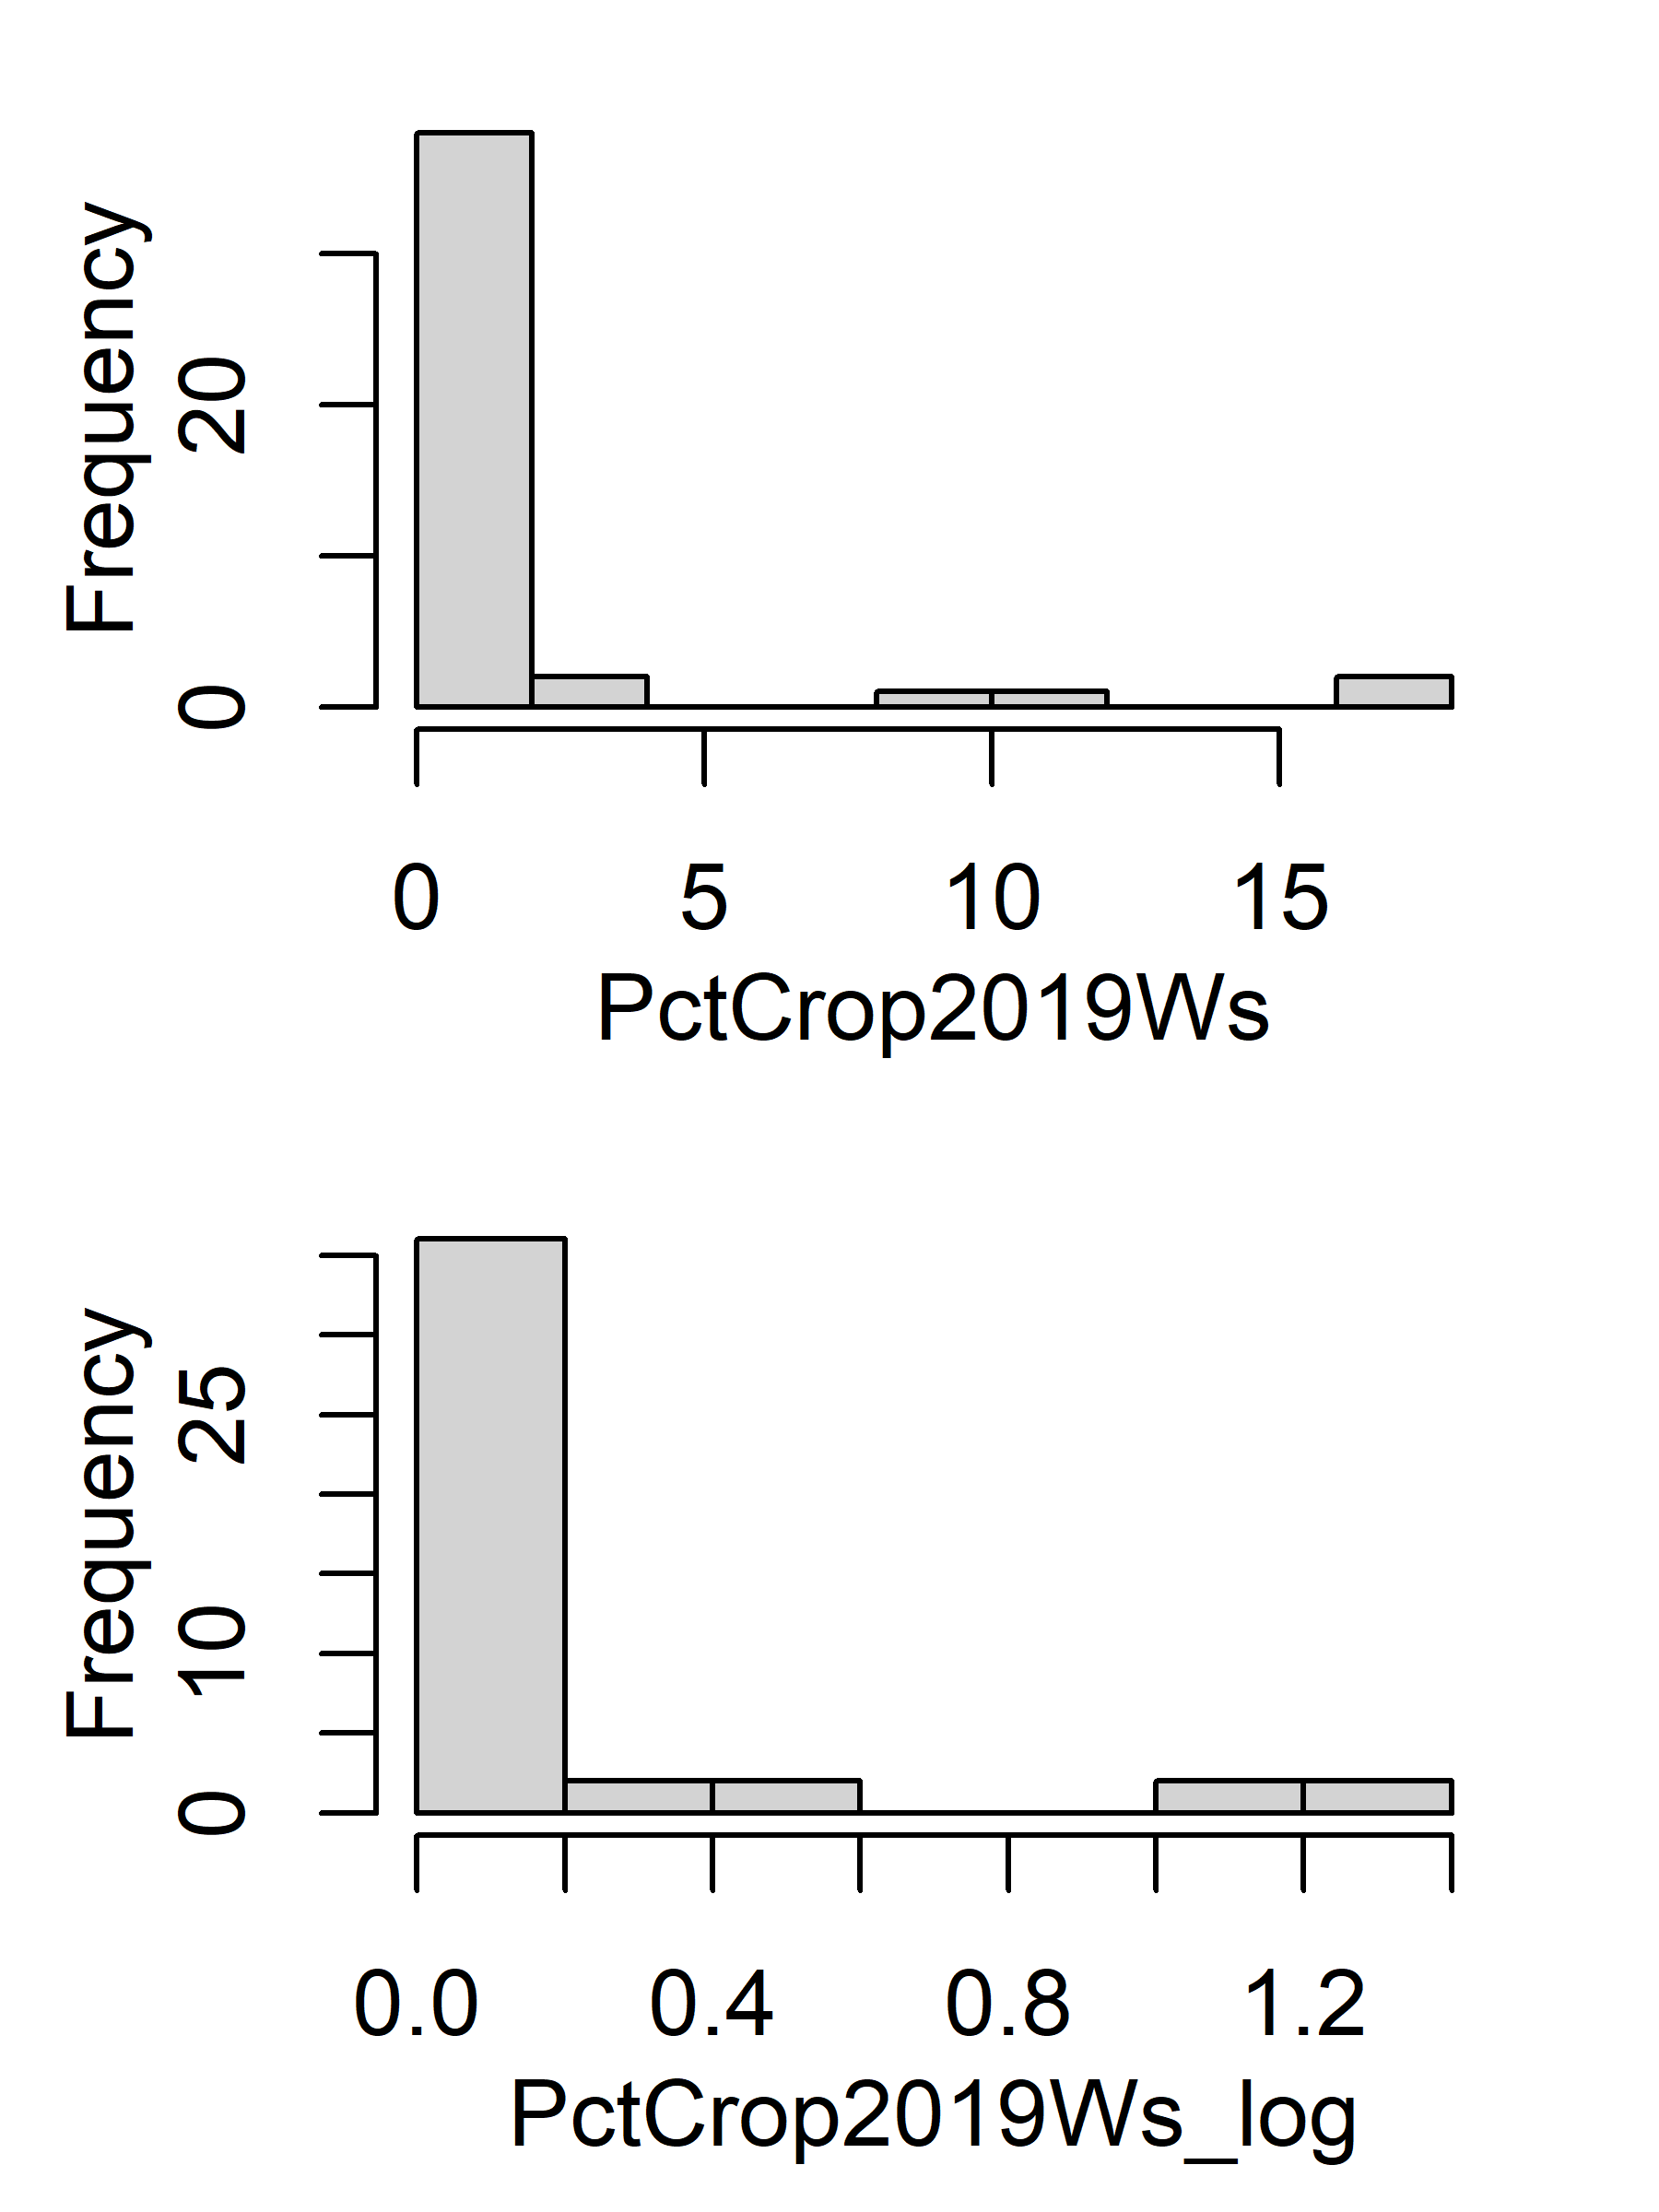
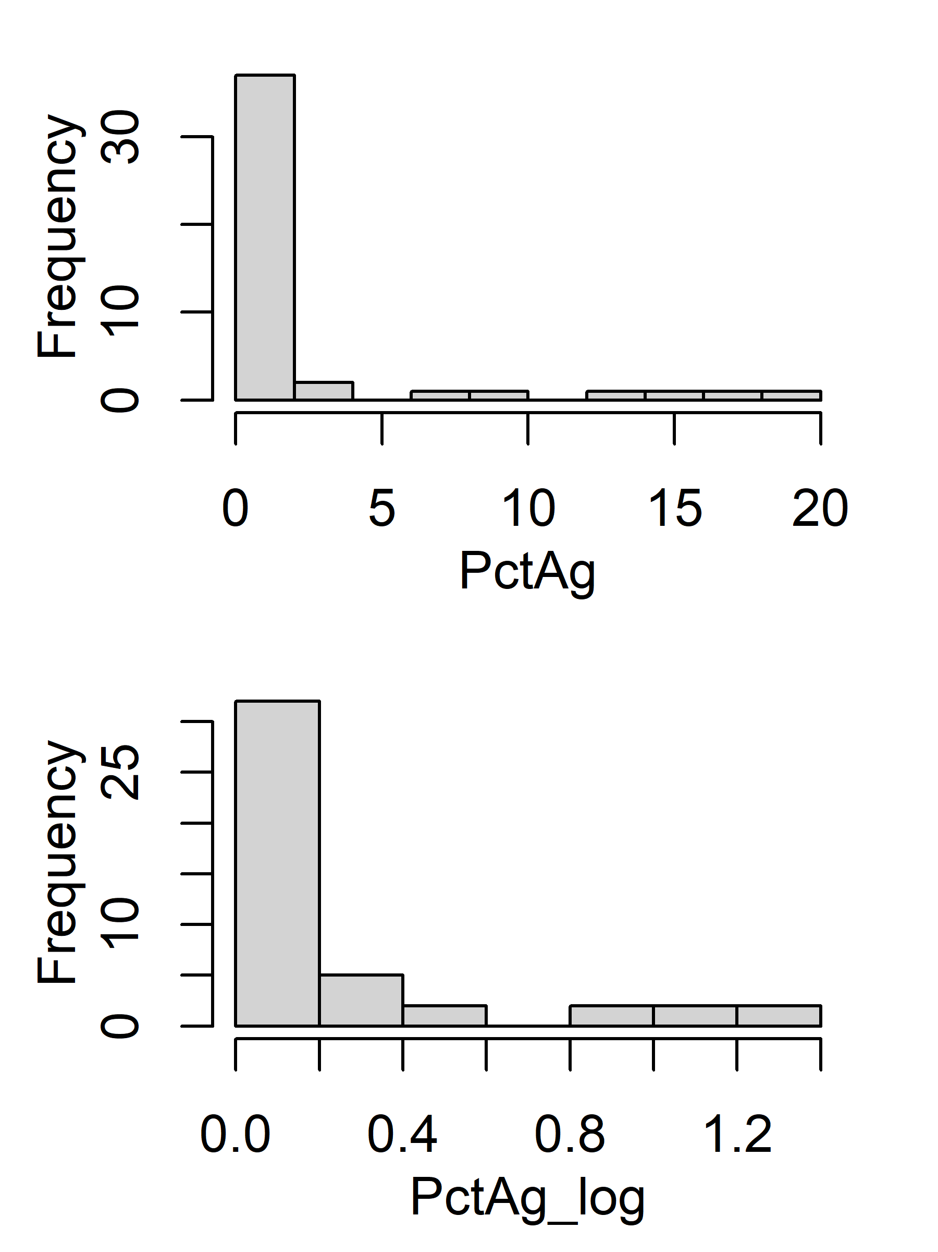
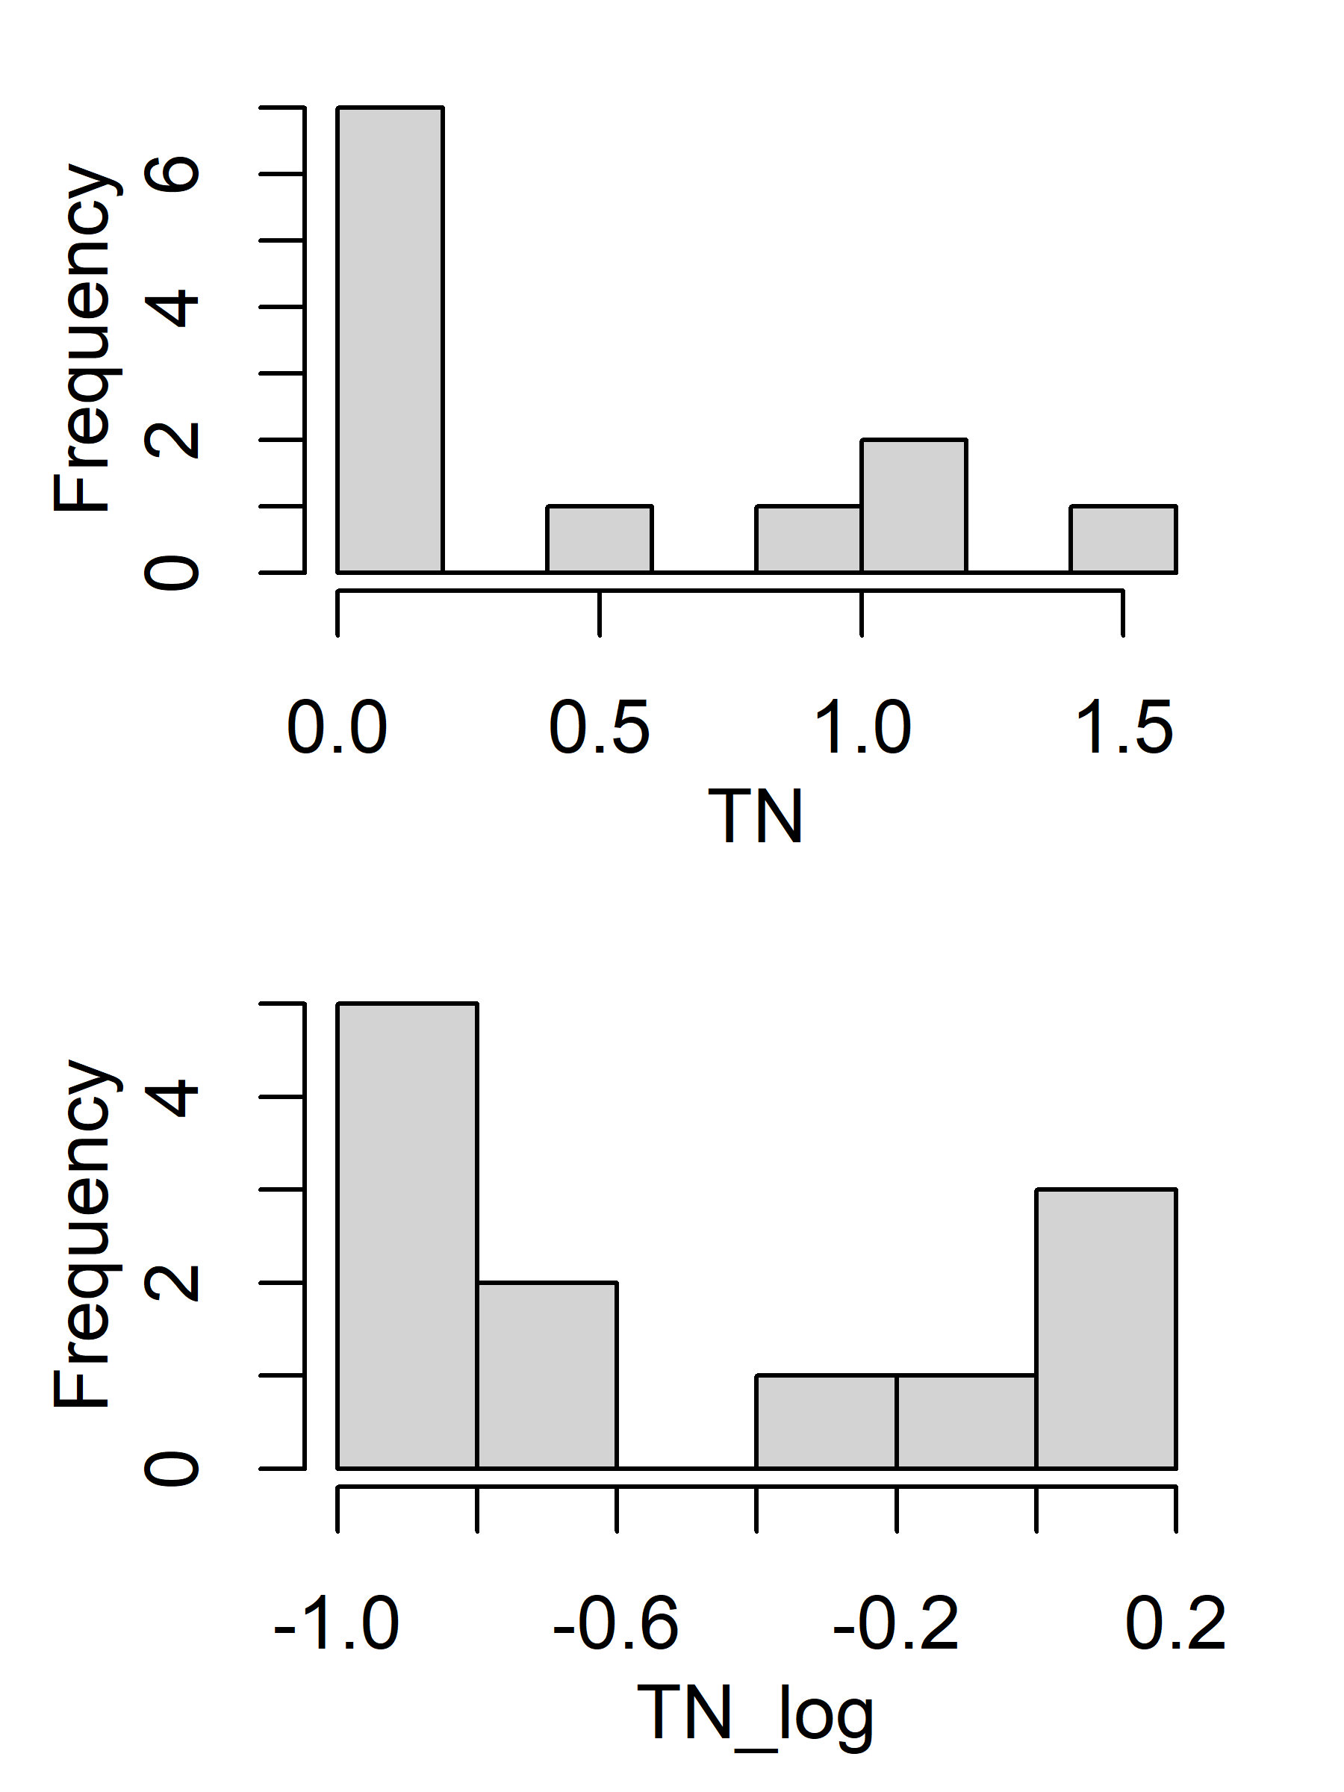
Histogram (original vs log)
#%Forest(PctFst) = %Coniferous+%Evergreen + %Mix
%Ag(PctAg) = %Crop + %Pasture/Hay;

Slide 6
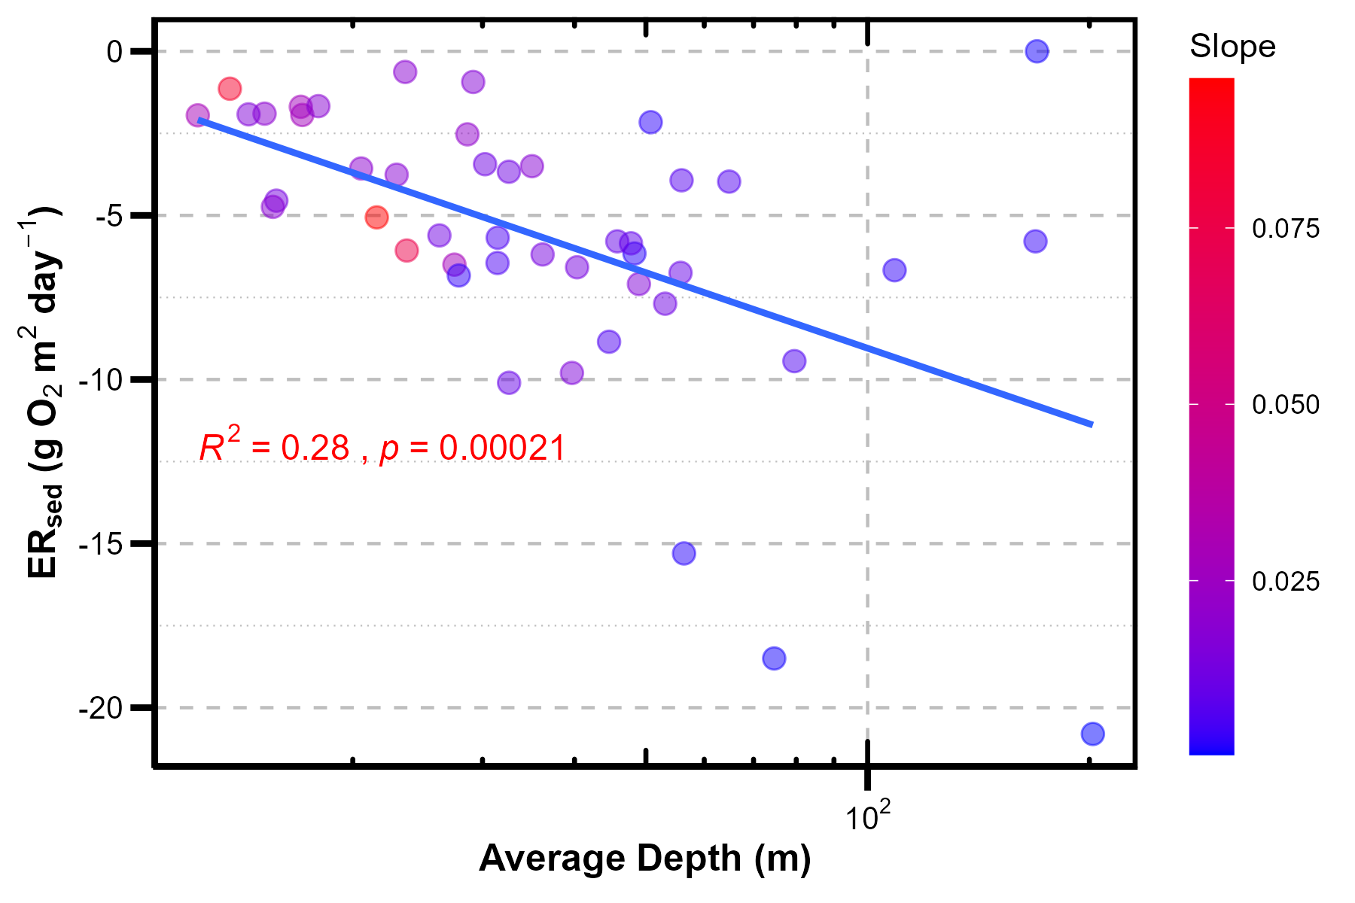
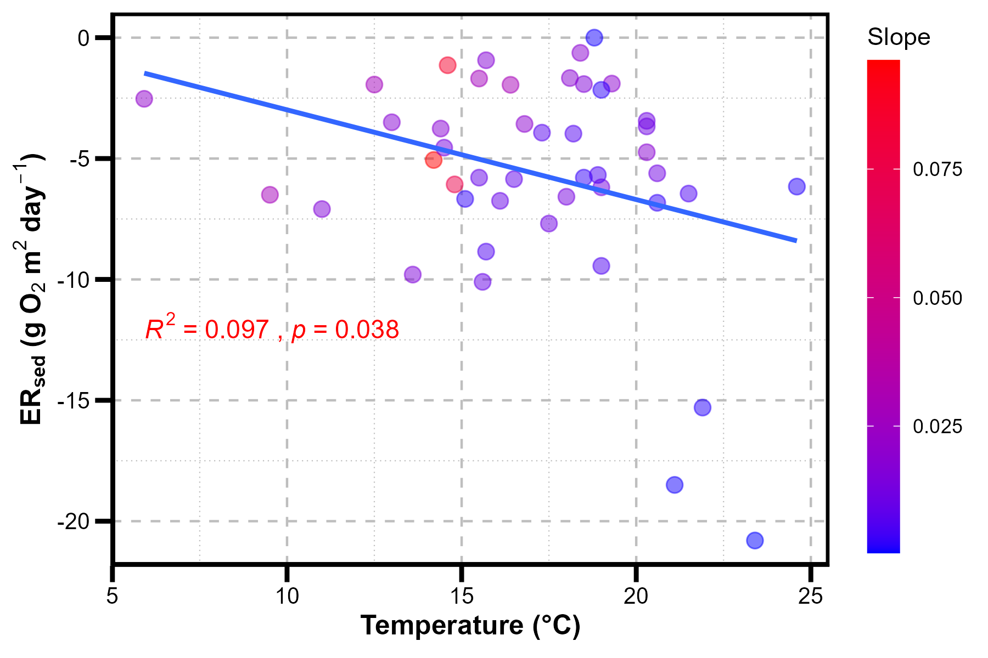
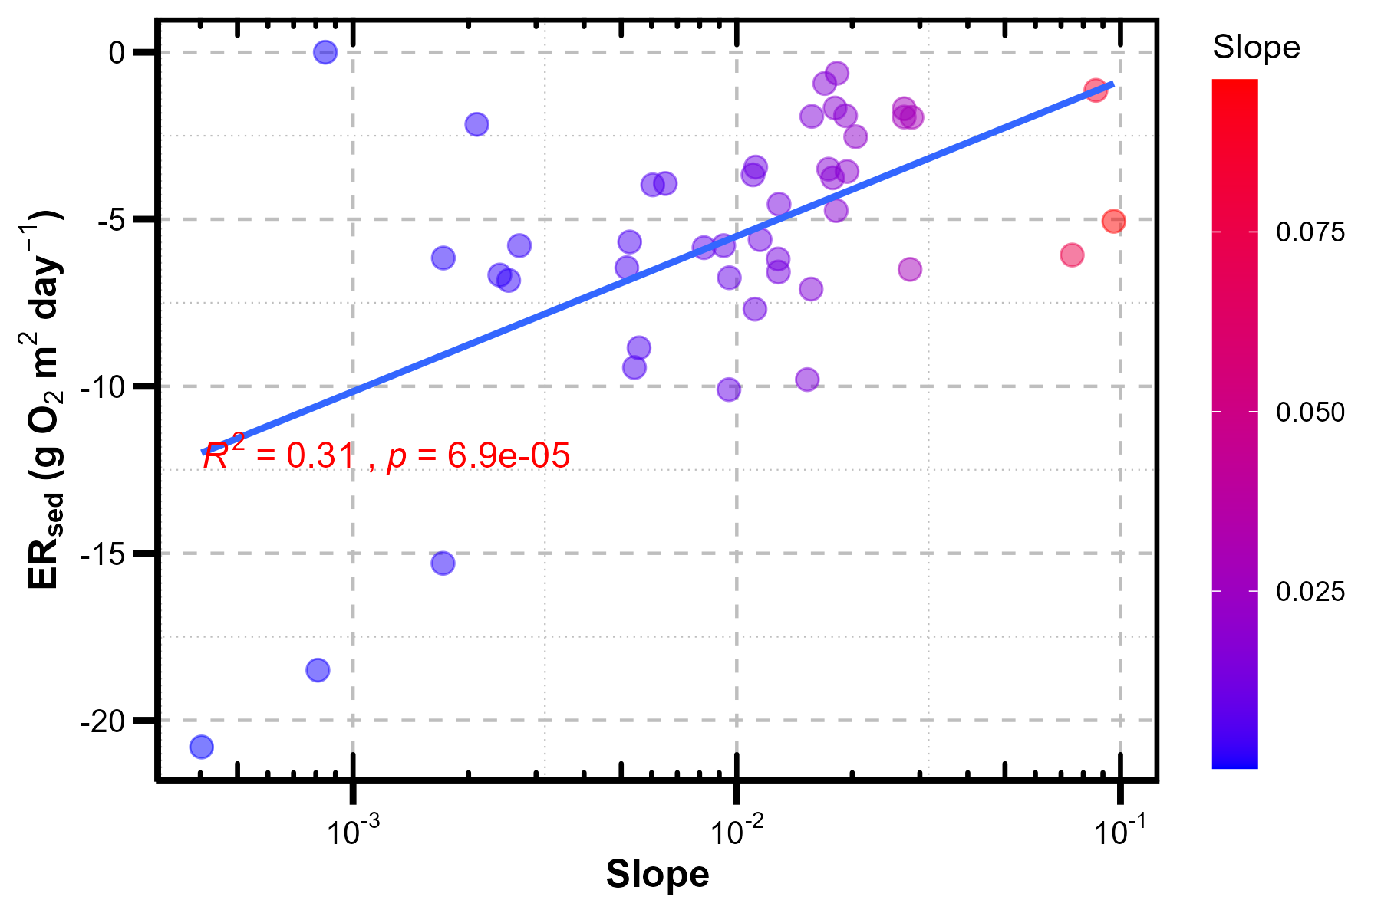
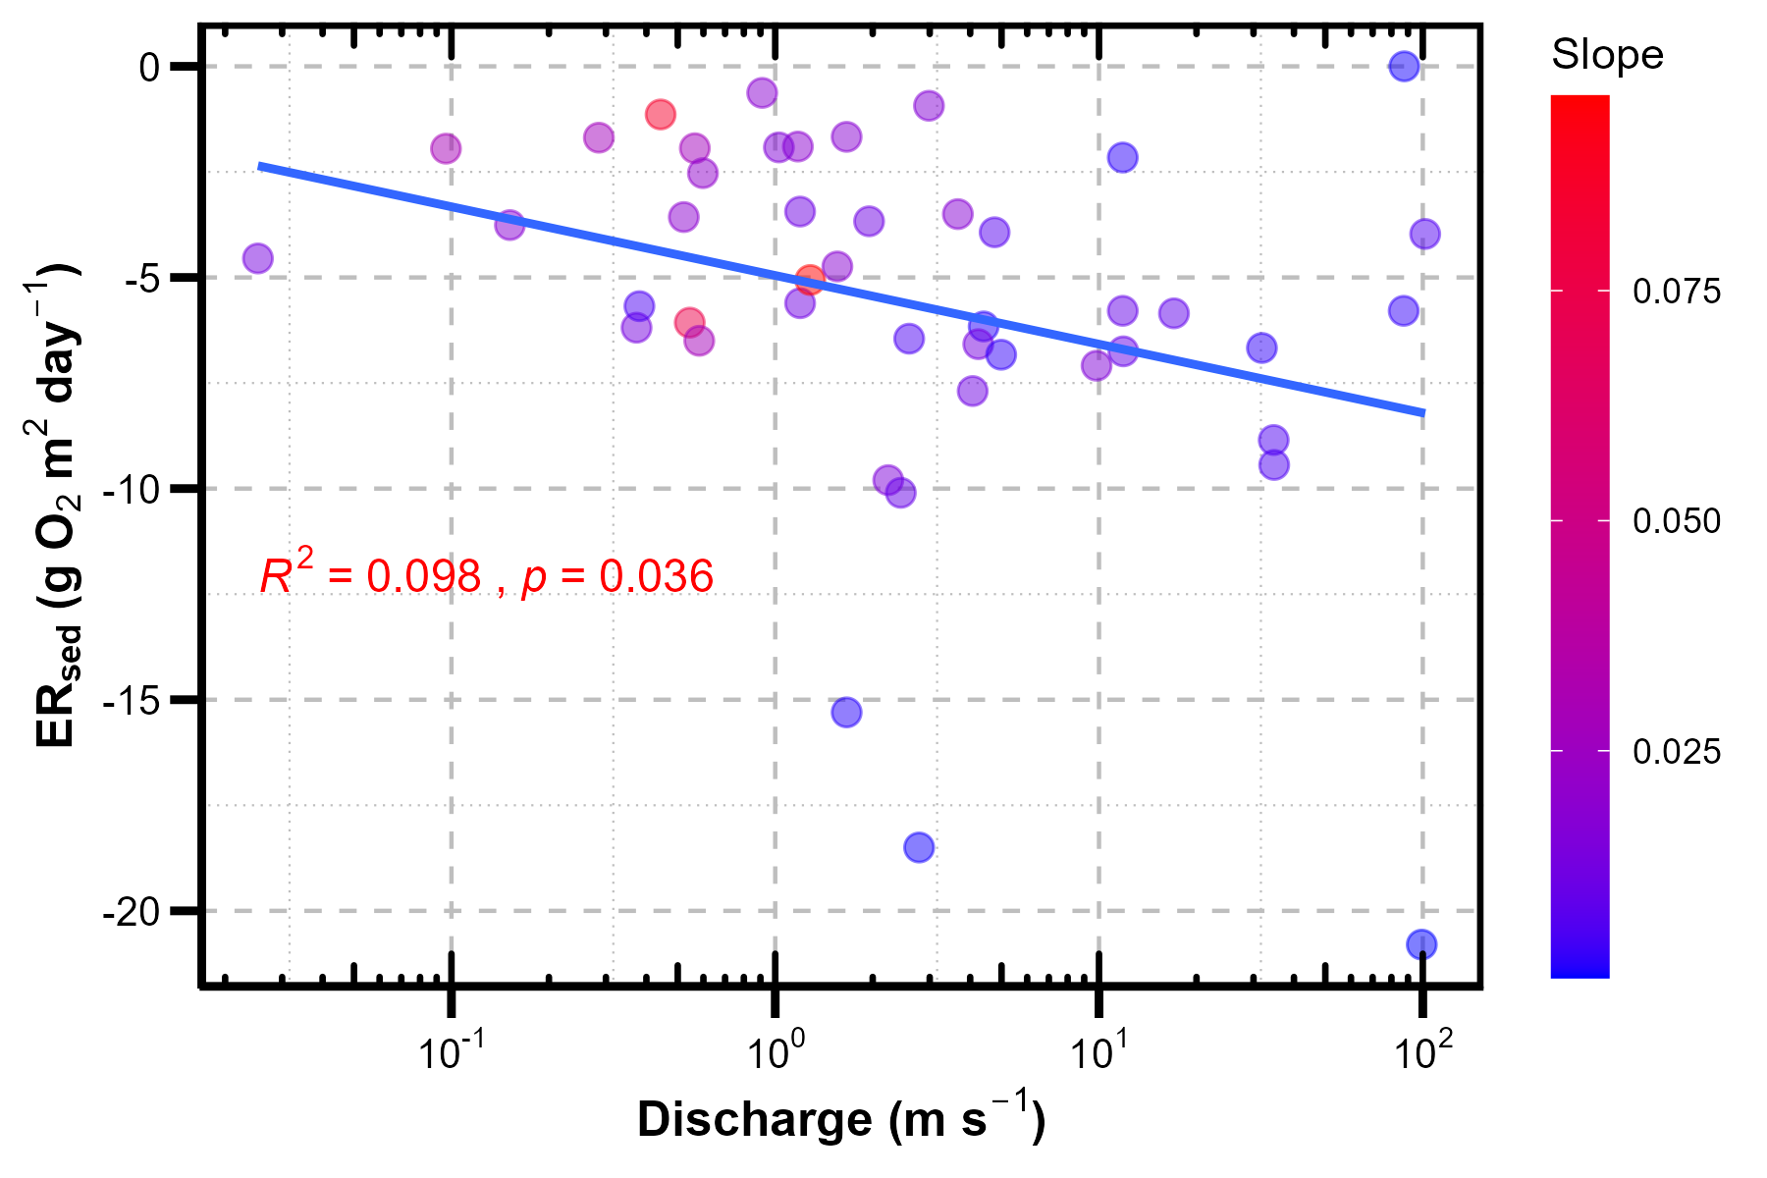
Scatterplot between ERsed and variables

Slide 7
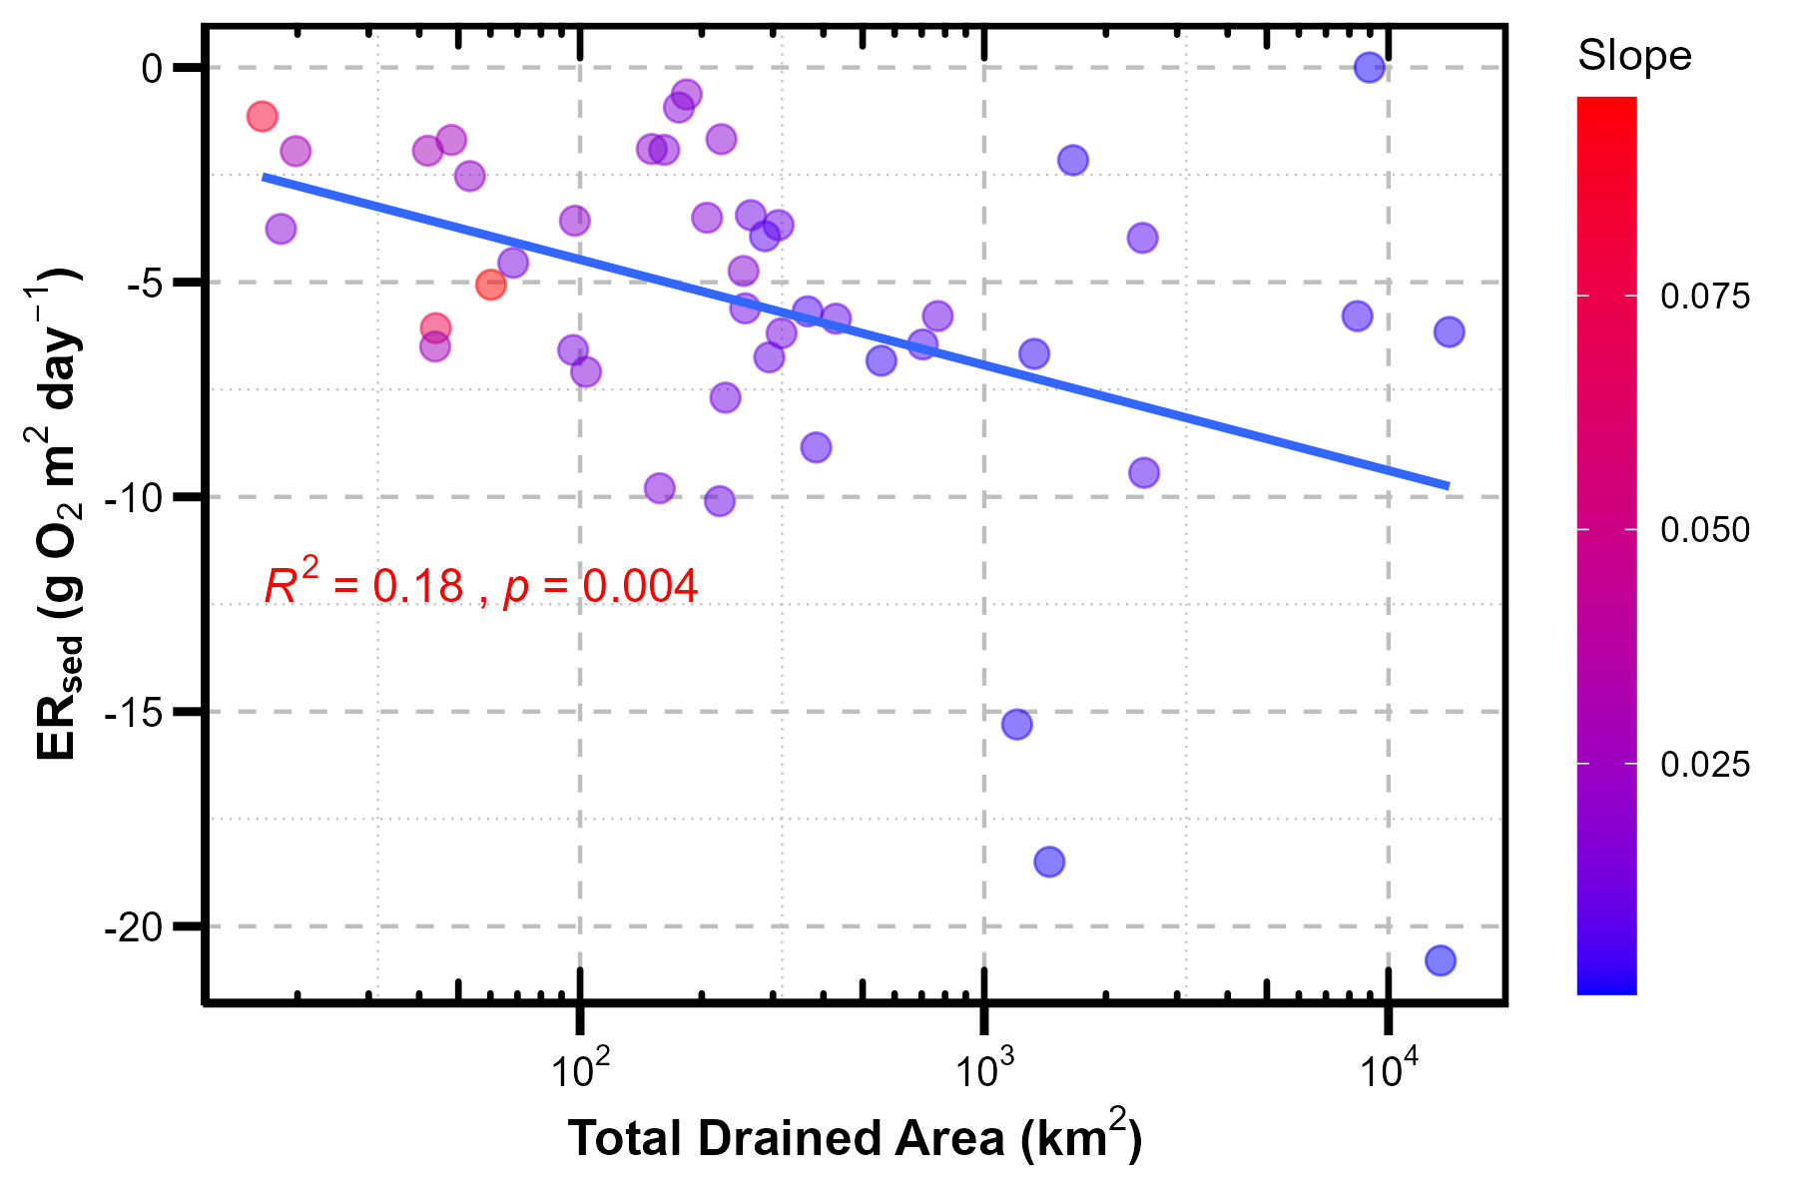
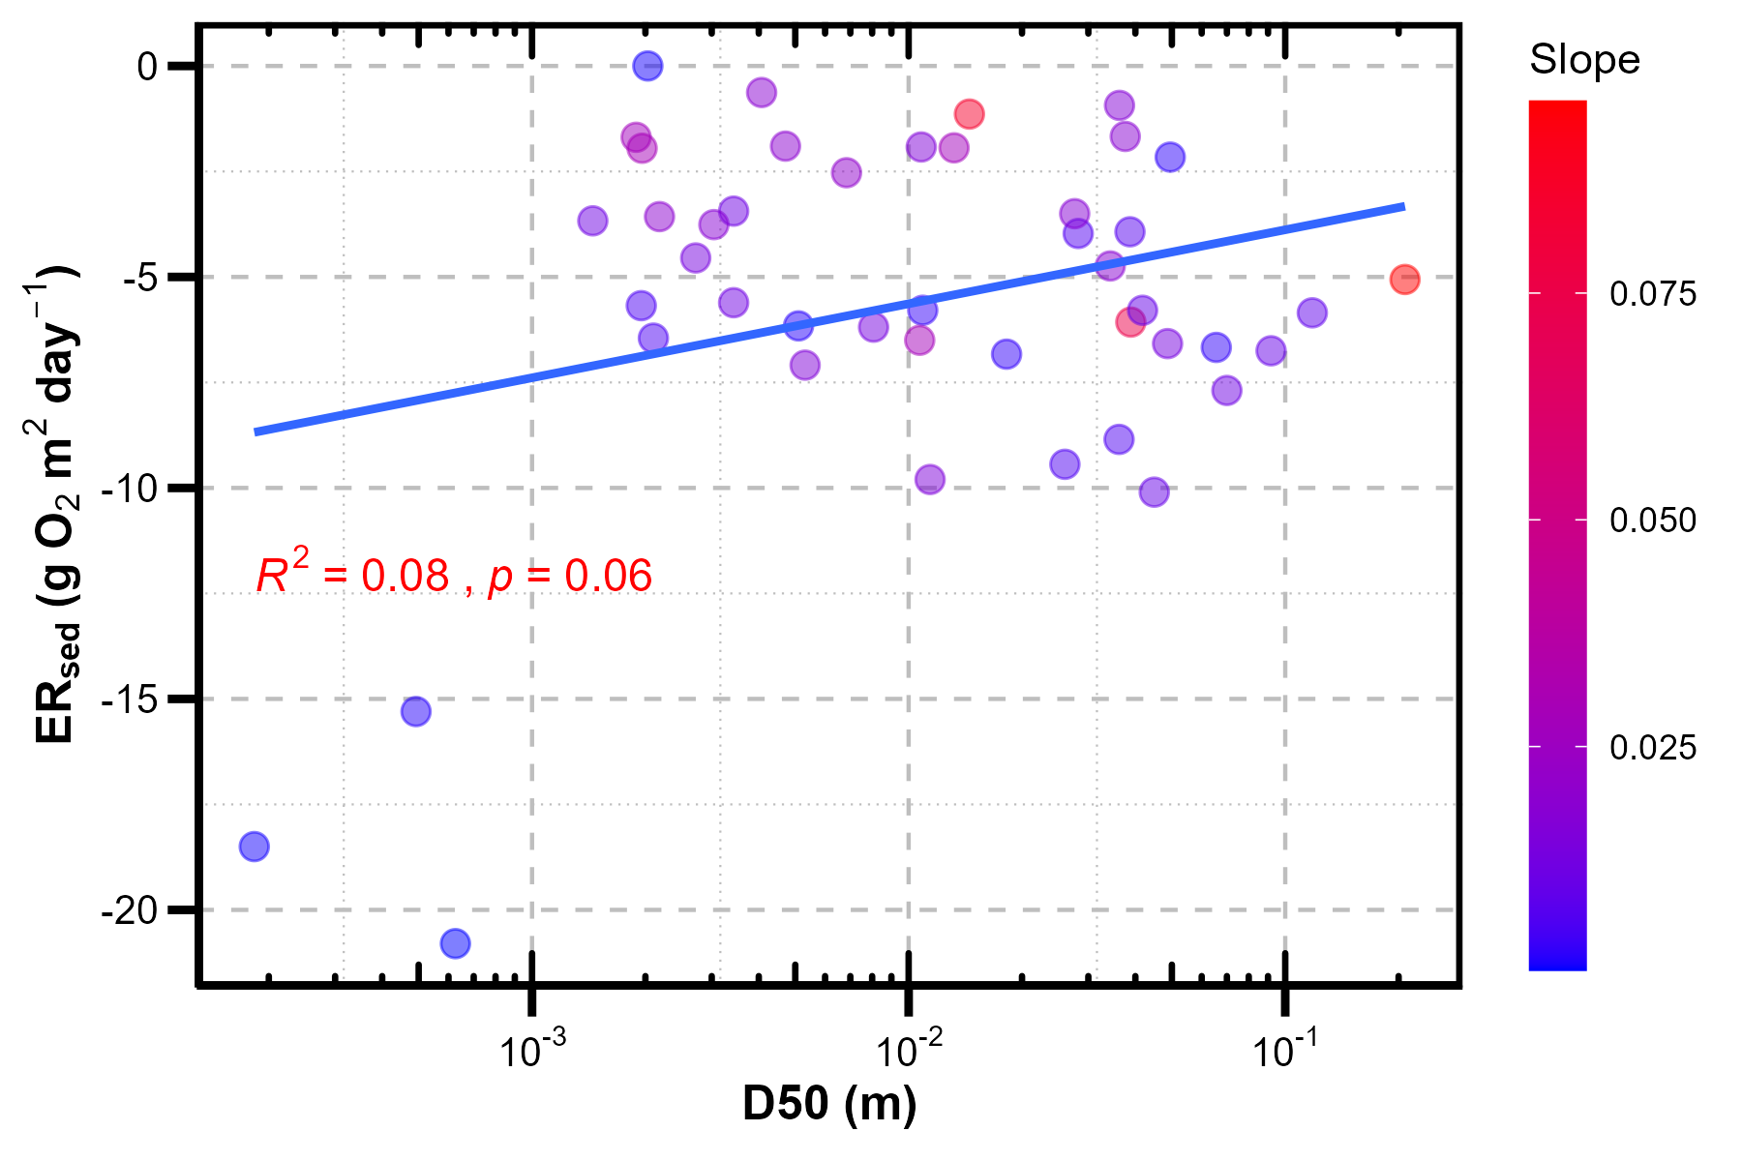
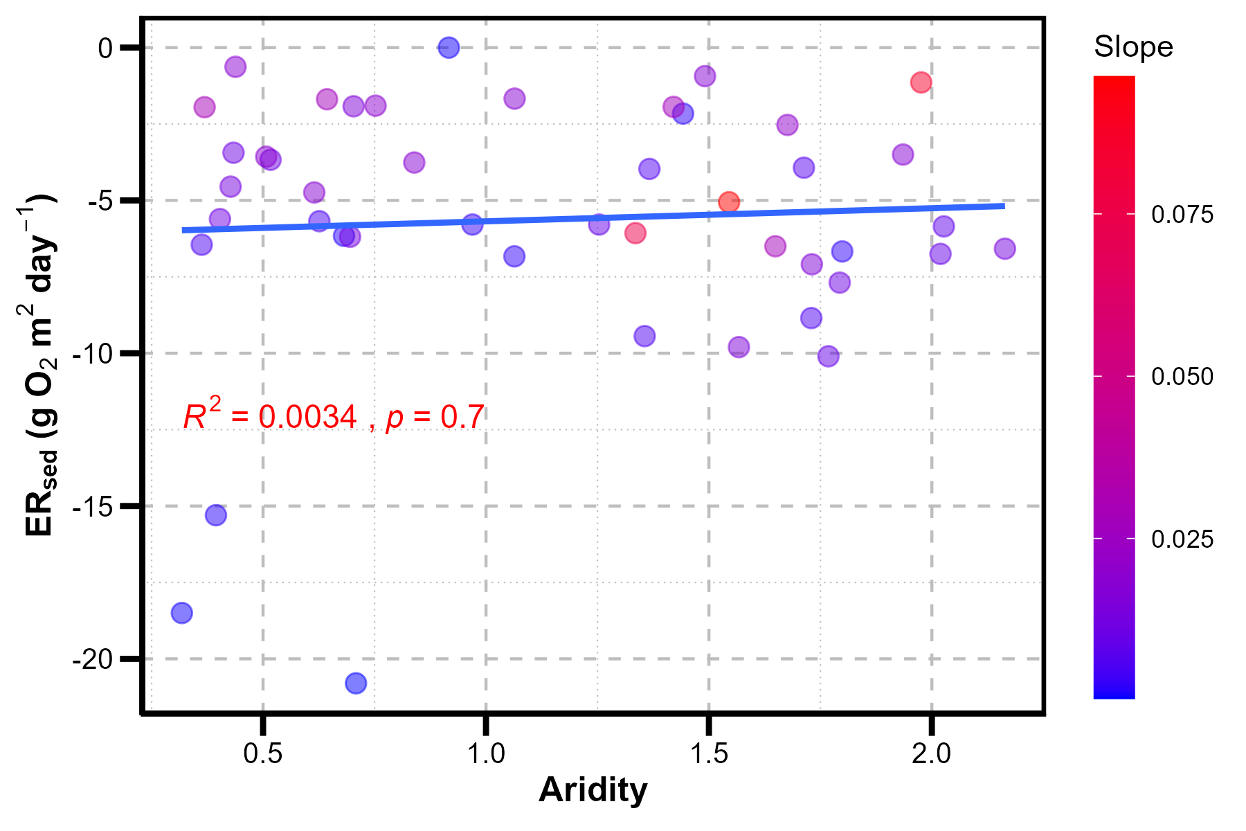
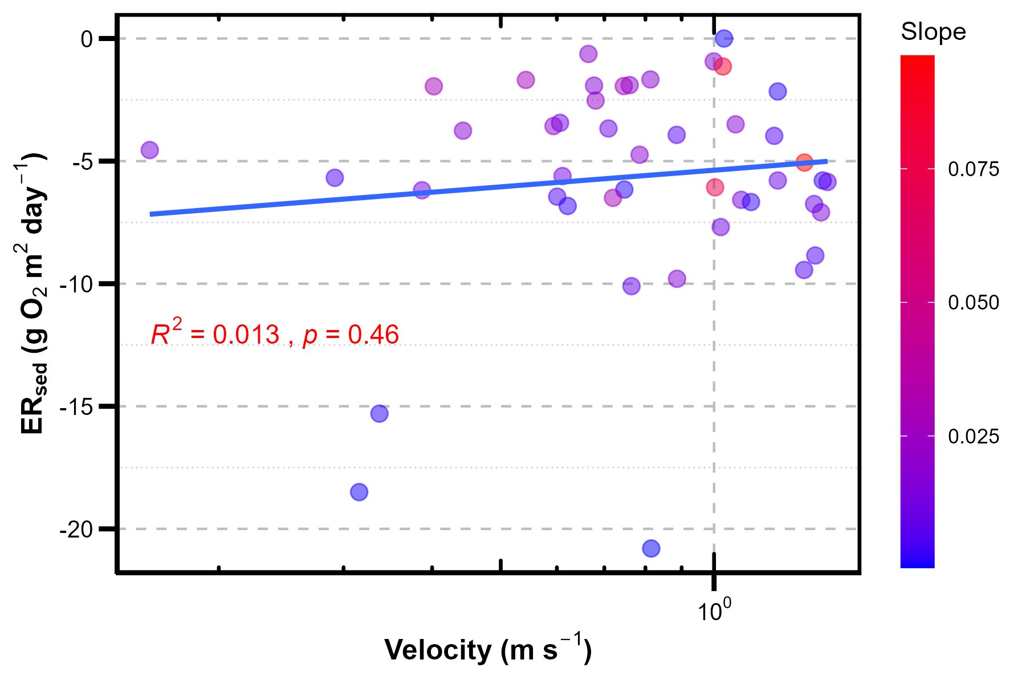
Scatterplot between ERsed and variables

Slide 8
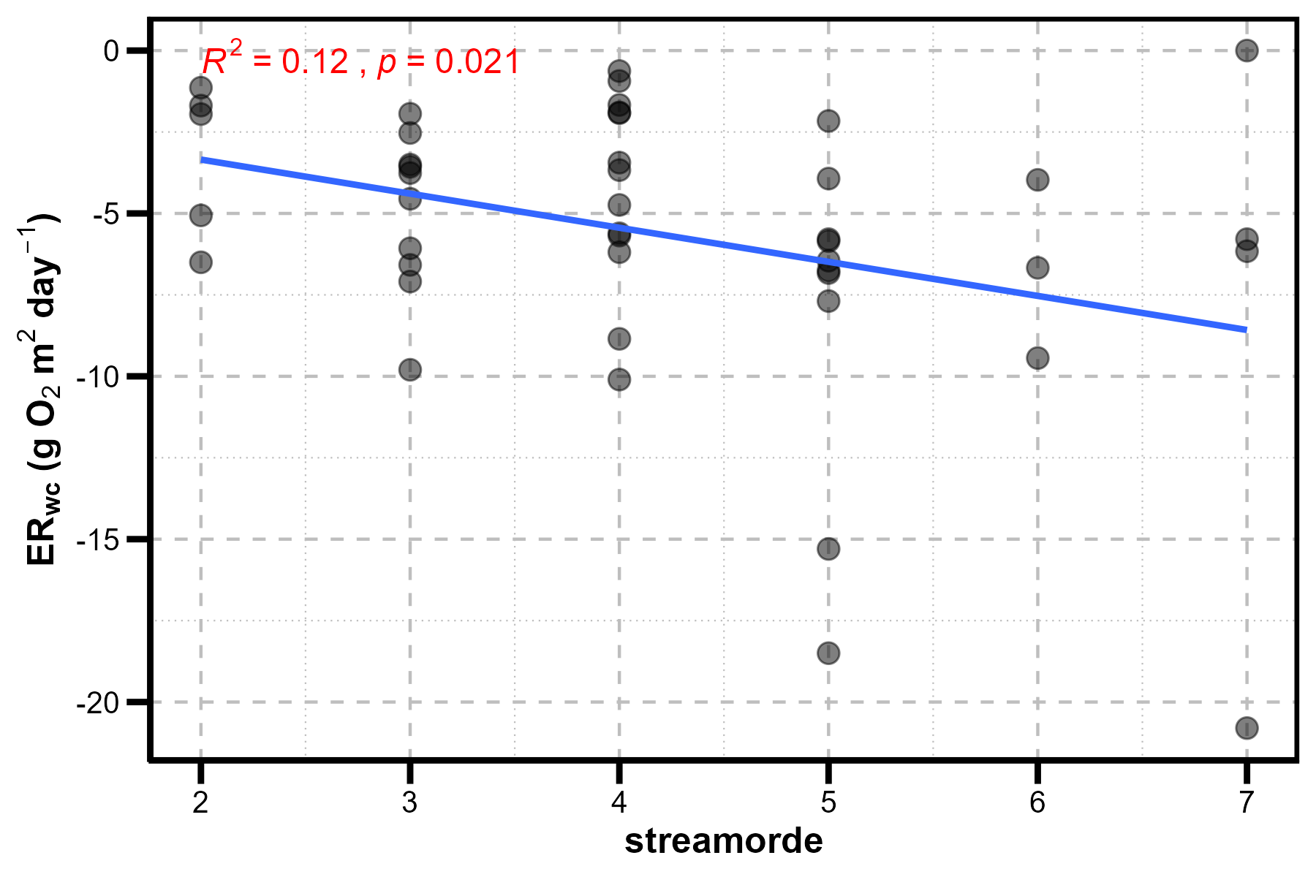
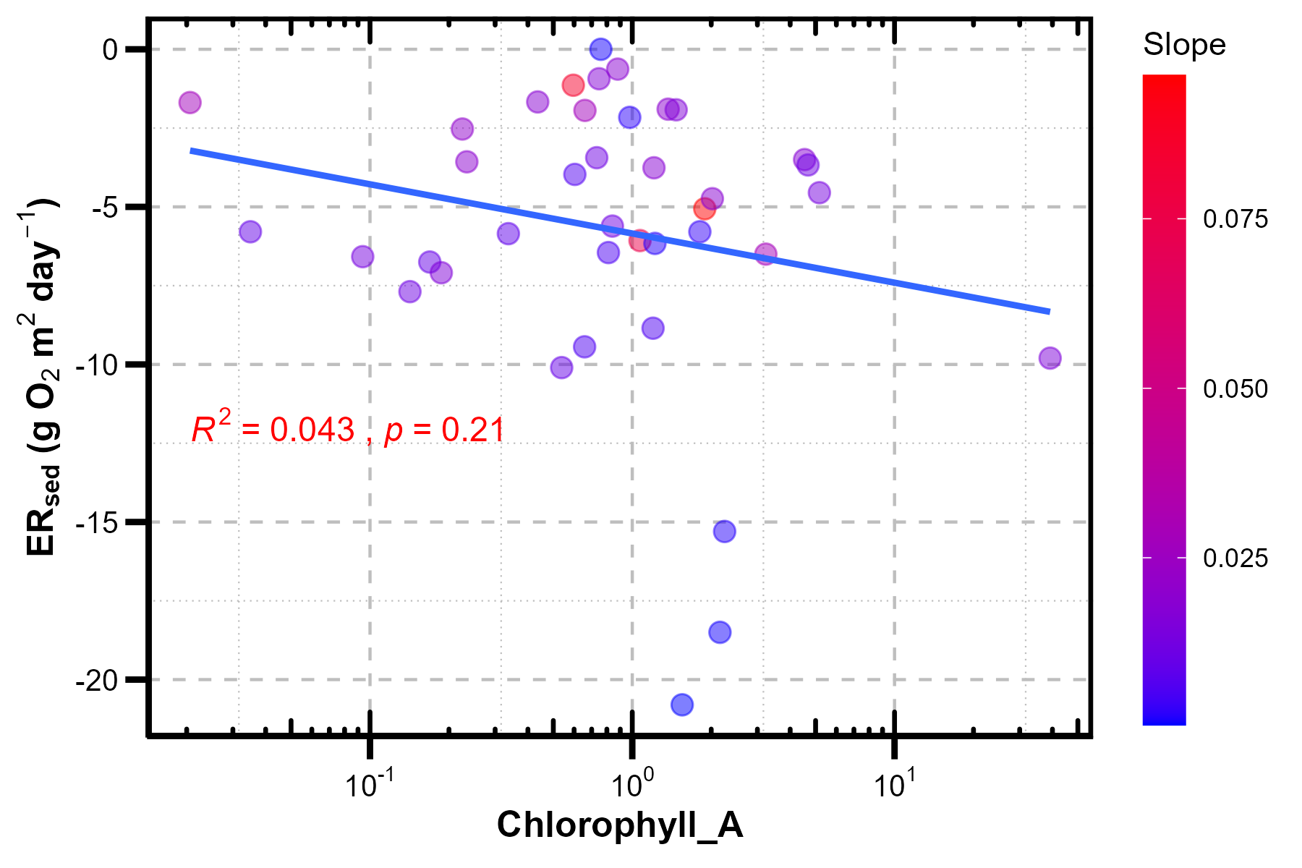
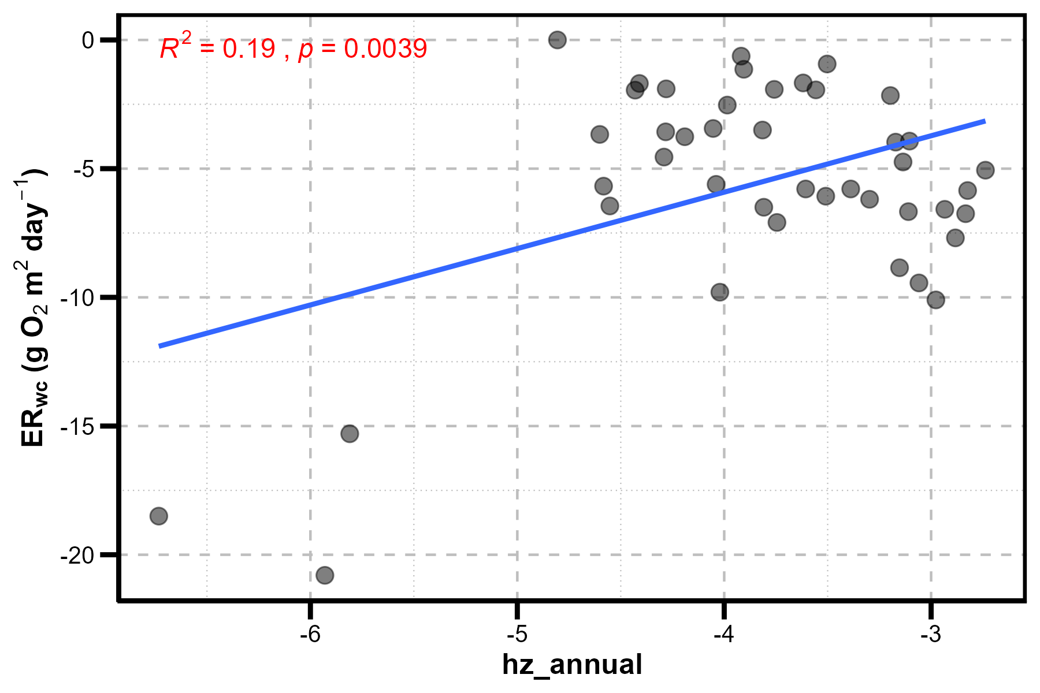
Scatterplot between ERsed and variables

Slide 9
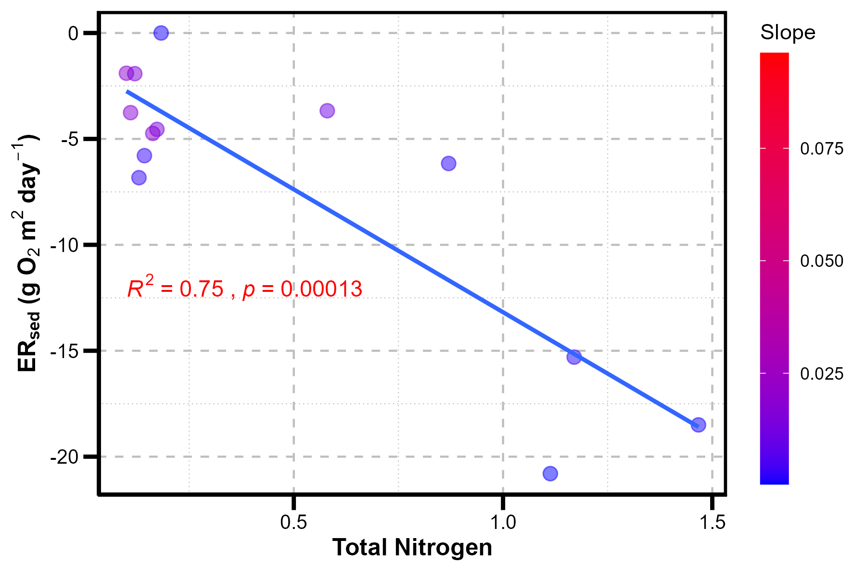
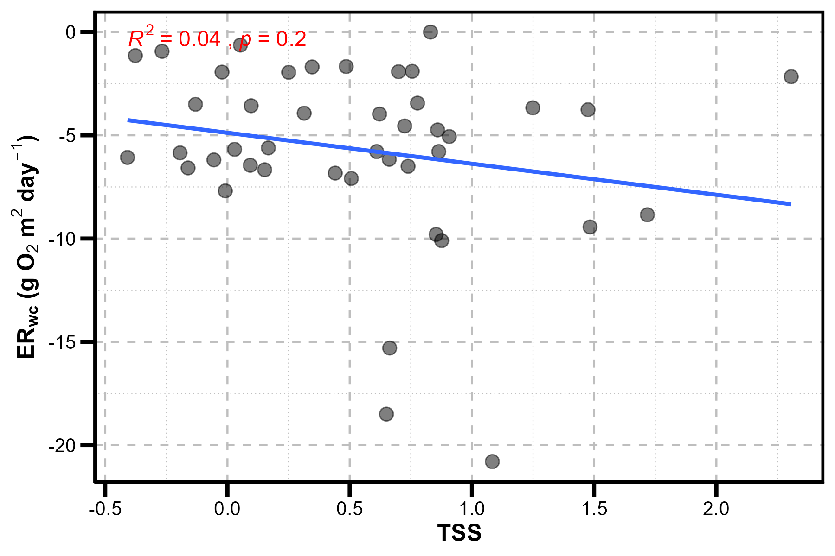
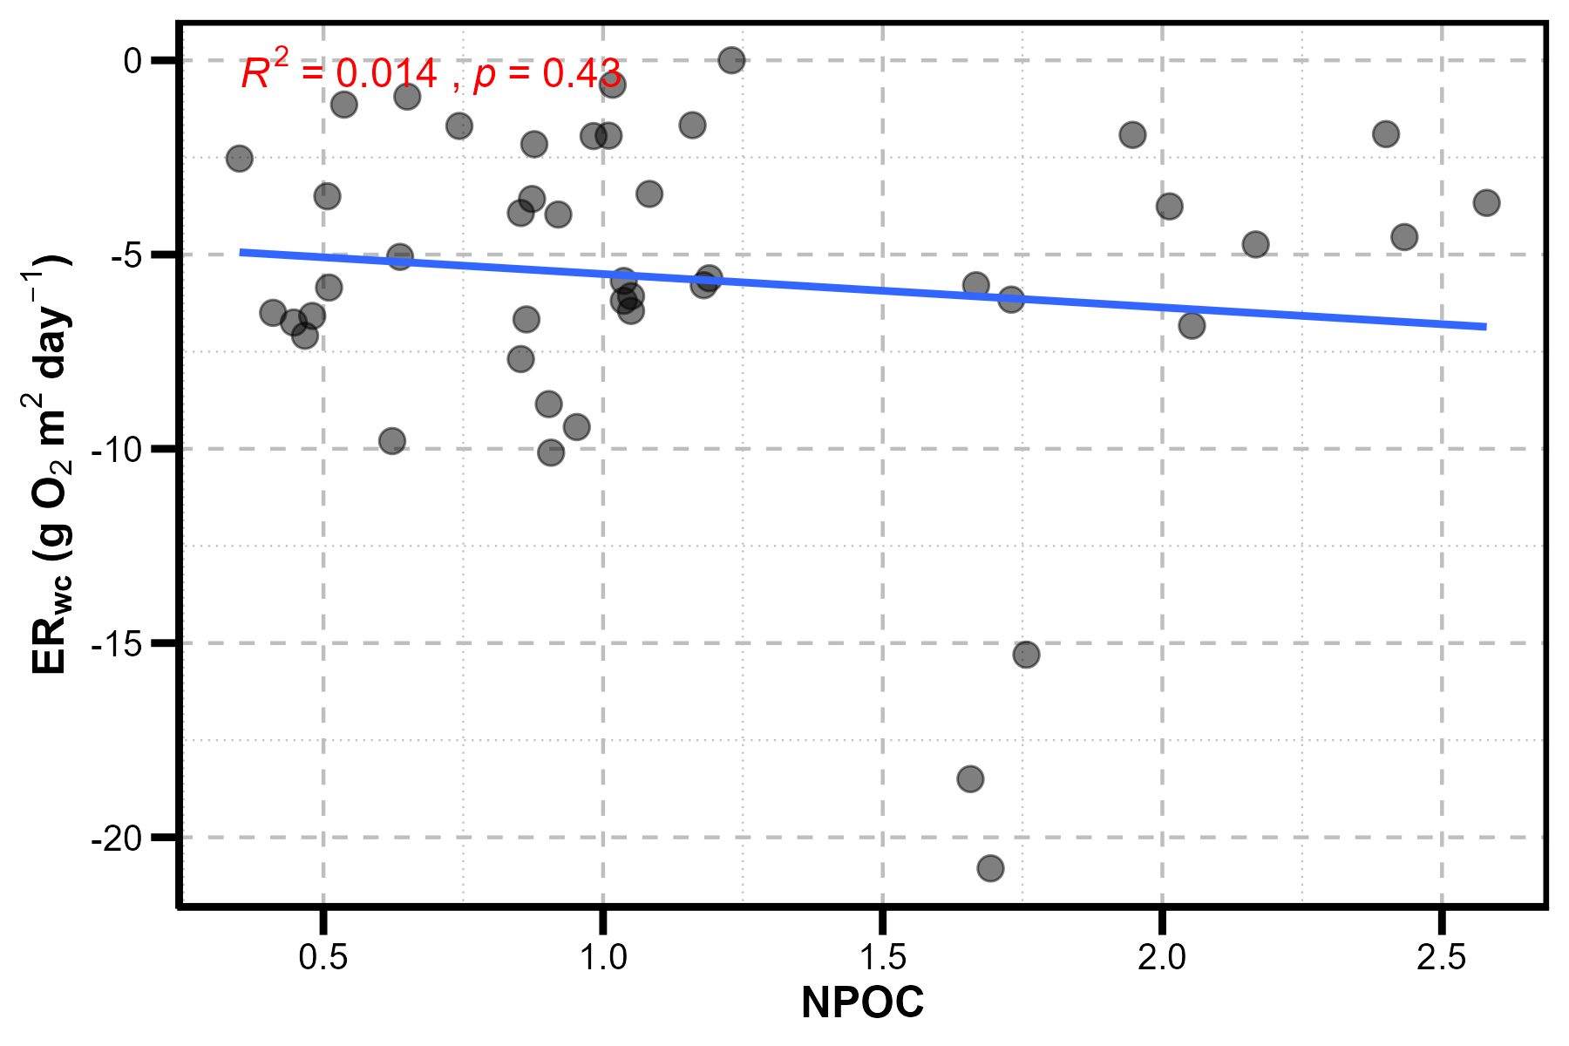
Scatterplot between ERsed and variables

Slide 10
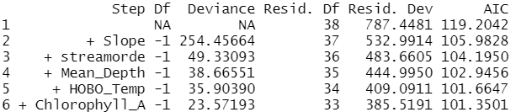
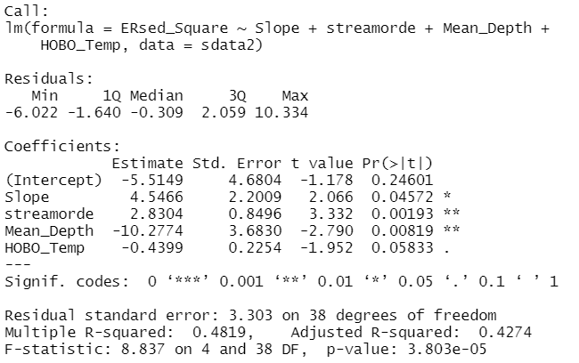
Forward selection -ERsed
Forward stepwise-selected variables (variables to keep in model):
Summary statistics for the lm model fitted using the selected variables(i.e., Slope, streamorde, Mean_Depth, HOBO_Temp)

Slide 11
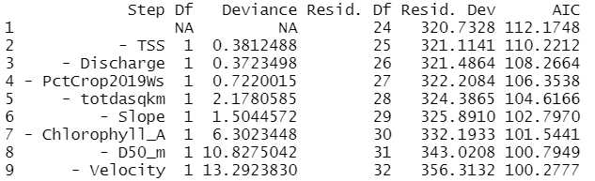
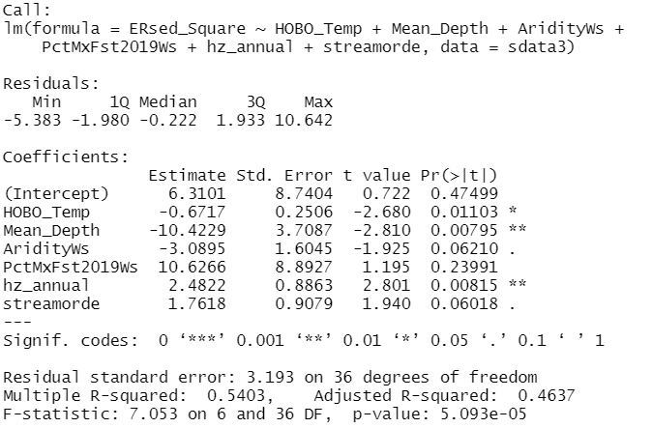
Backward selection - ERsed
Backward stepwise-selected variables (variables to remove in model):
Summary statistics for the lm model fitted using the selected variables(i.e., HOBO_Temp, Mean_Depth, AridityWs, PctMxFst2019Ws, hz_annual, streamorde)

Slide 12
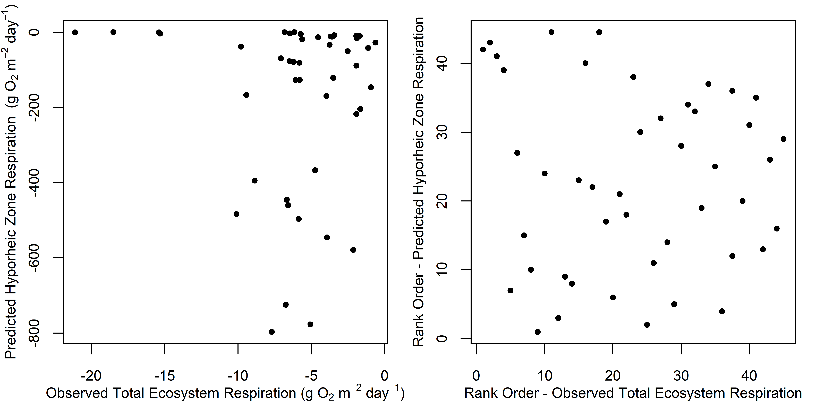
Scatter plot between predicted and observed ERsed
(a)
(b)

Slide 13
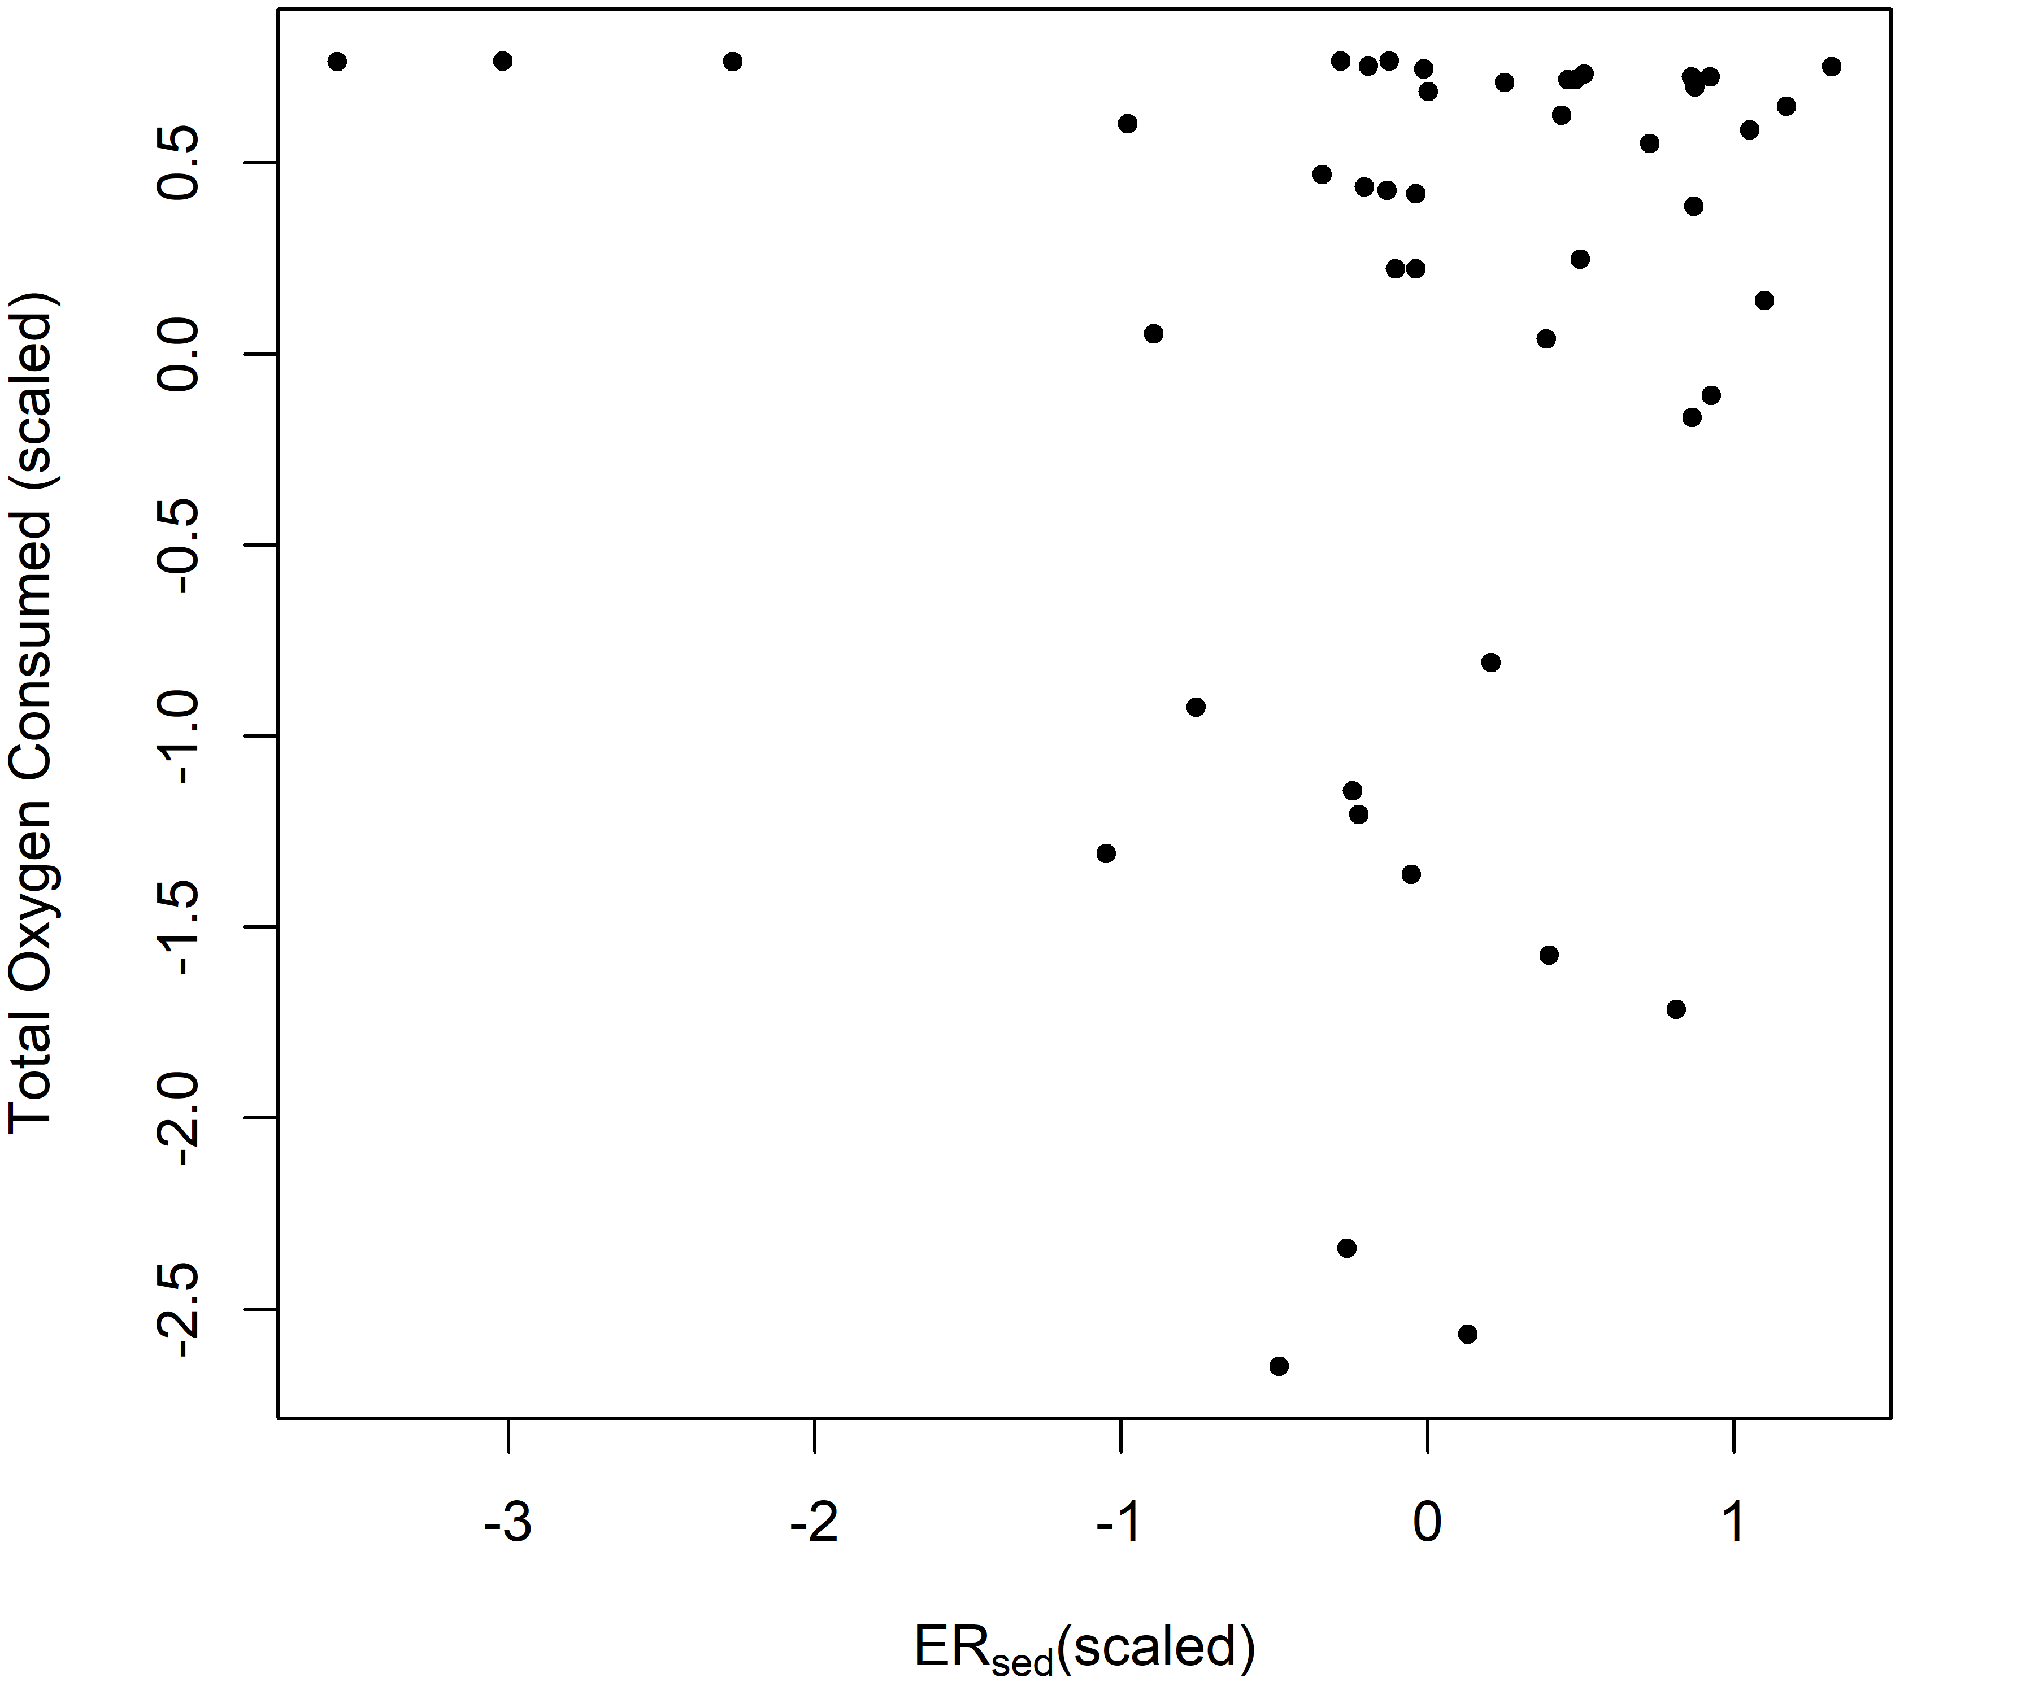
Scatter plot between predicted and observed ERsed

Slide 14
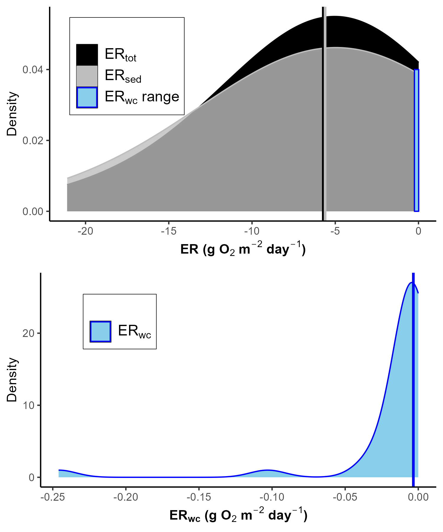

Density plot
(a)
(b)

Slide 15
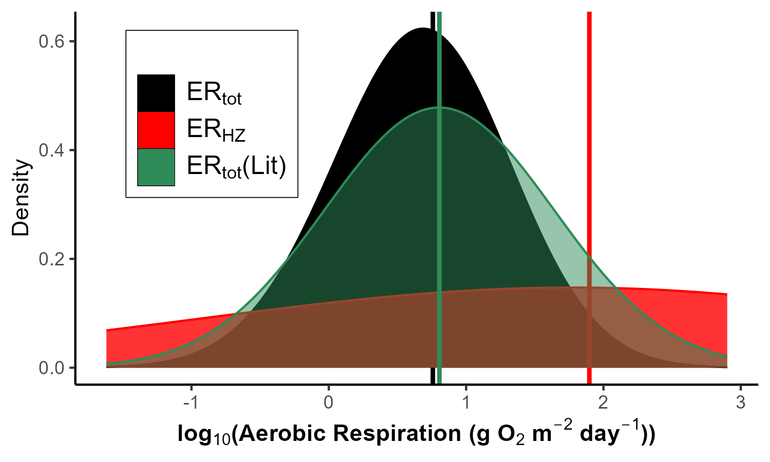
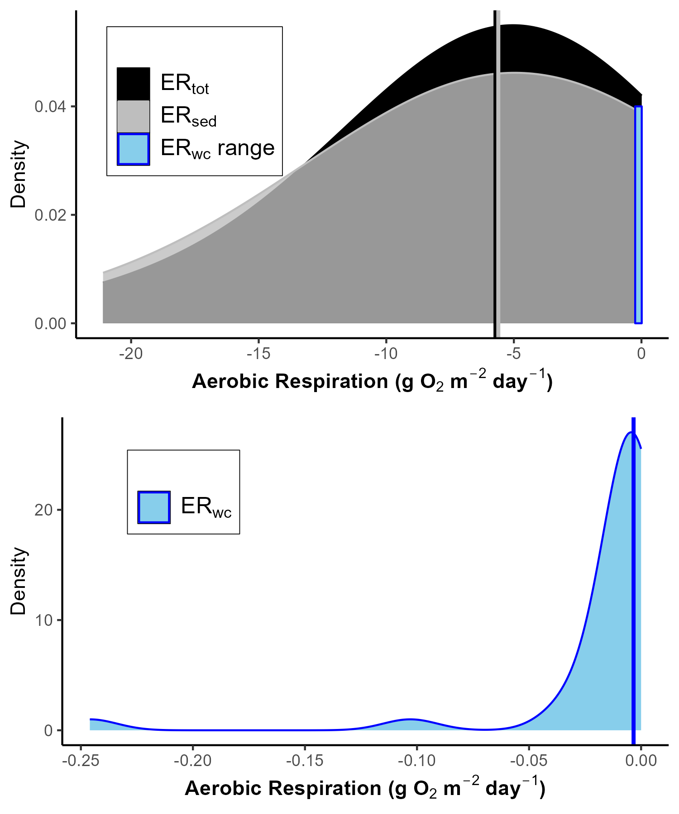
Density plot
(a)
(b)
(c)

Slide 16
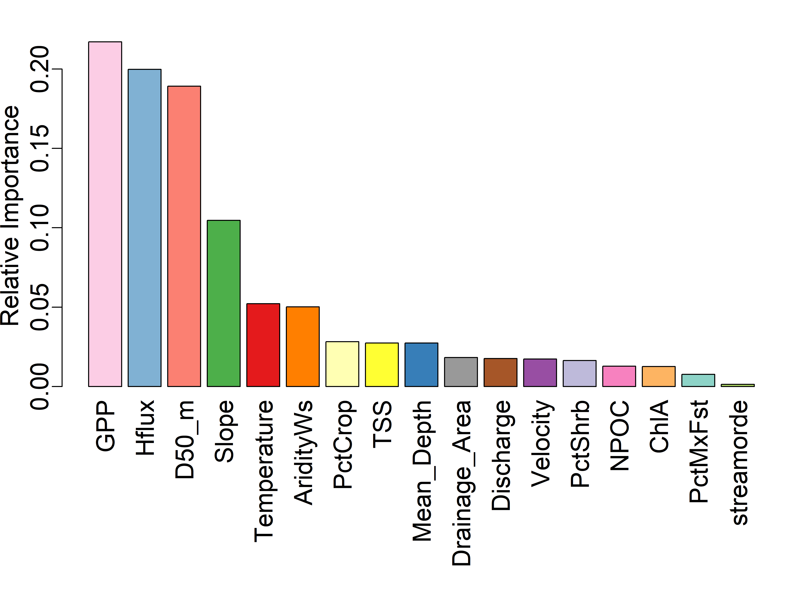
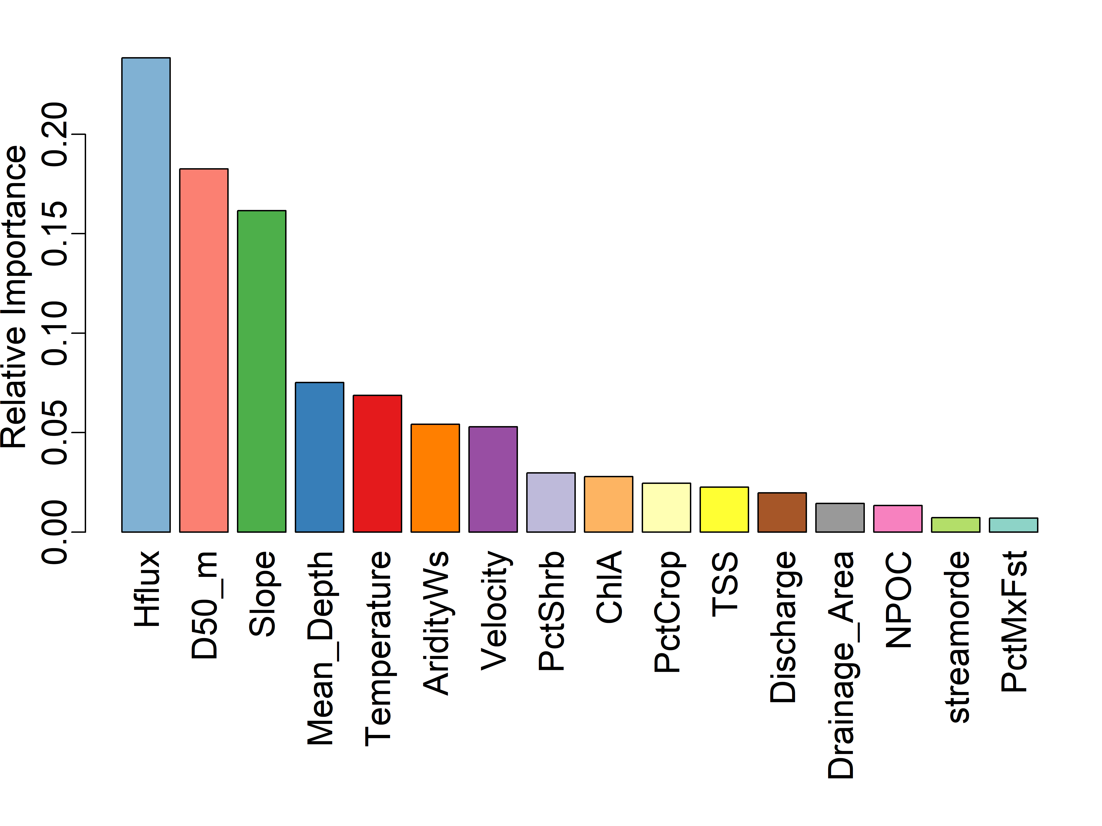
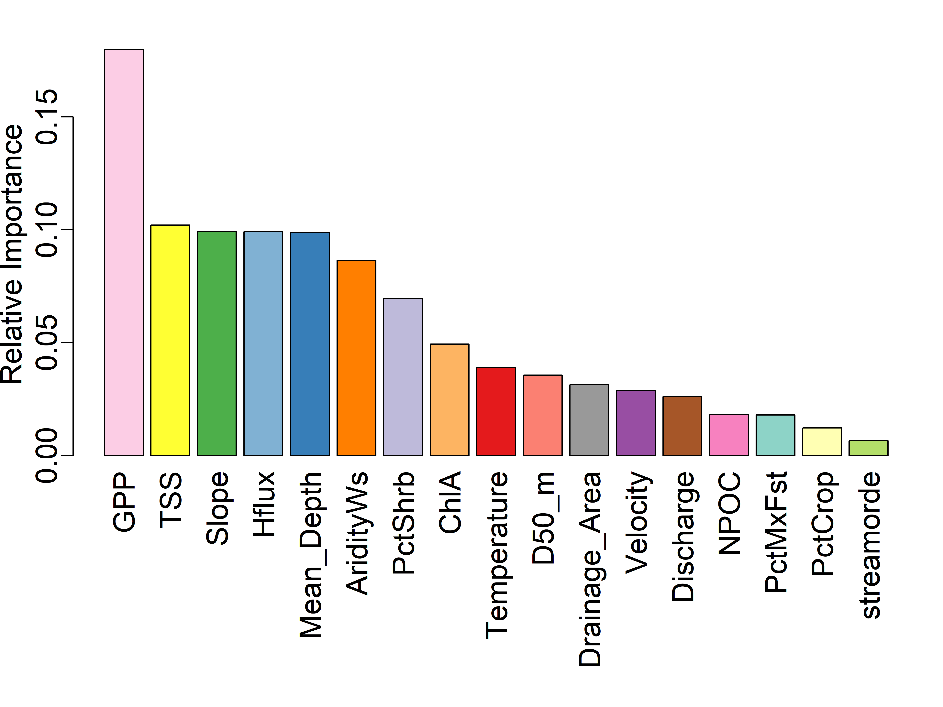
Random Forest(RF) - ERsed
RF was built using variables without log transform (100 trees )
All variables except TN
R2 ~50%
Drop GPP
R2 ~40%
Drop 3 fastest ER rates
R2 ~5% (small variation in ERsed?)

Slide 17
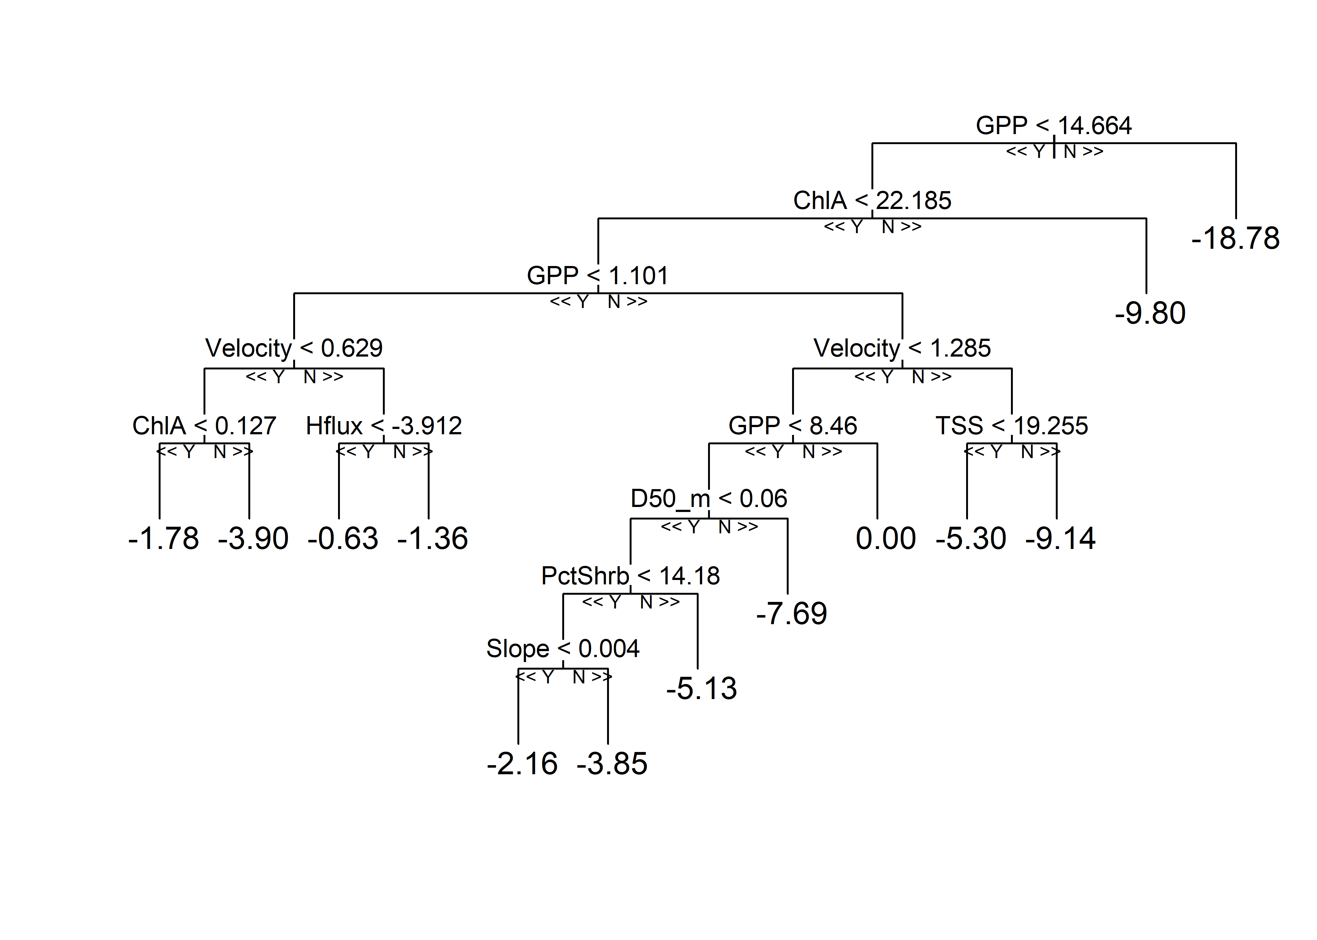
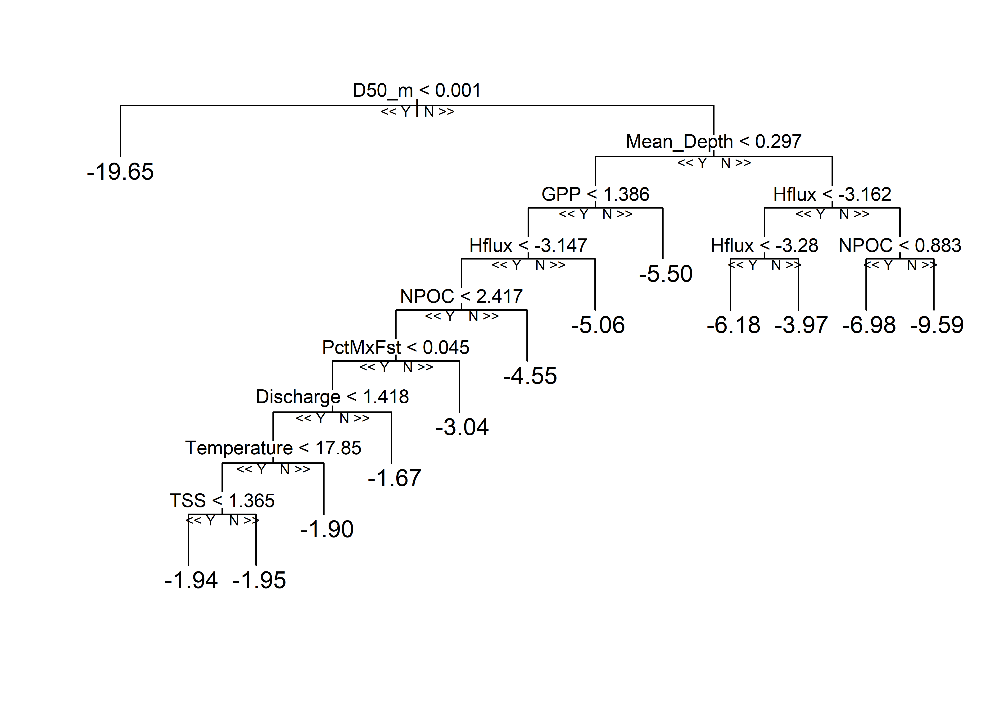
Selected Trees in Random forest
RF was built using all variables without log transform (100 trees )

Slide 18


Selected trees in Random forest
RF was built using all variables except GPP

Slide 19


Selected trees in Random forest
RF was built using all variables after dropping 3 fastest ER rates

Slide 20

Segmented regression for GPP and ERsed

Slide 21




Random Forest(RF) - ERsed
RF was built using variables without log transform (100 trees )
Add TN filled with half of the minimum observed value
All variables
R2 ~58%
Drop GPP
R2 ~56%
Drop 3 fastest ER rates
R2 ~5% (small variation in ERsed?)
GPP as target variable
R2 ~56%

Slide 22


Random Forest(RF) - ERsed
RF was built using variables with 100 trees
Add TN filled with half of the minimum observed value
Log(ERsed)
R2 ~20%
Log(all variables)
R2 ~7%

Slide 23





Shapley additive explanations (SHAP)
SHAP values are based on cooperative game theory and provide a theoretically sound method for fair feature attribution.
SHAP explains the predictions of the model by attributing the contribution of each feature to the final prediction, represent the marginal contribution of each feature to the prediction
Positive SHAP values indicate that a particular feature is pushing the model's prediction higher compared to the expected baseline prediction.
Negative SHAP values indicate that a particular feature is pushing the model's prediction lower compared to the expected baseline prediction.
All variables
R2 ~58%

Slide 24




Shapley additive explanations (SHAP)

Slide 25




Shapley additive explanations (SHAP)
(a)
(a)
(b)
(c)
(d)

Slide 26


Shapley additive explanations (SHAP)
(a)
(b)

Slide 27

Summary statistics
 | Mean | Median | Range
$${ER}_{total}$$ | -5.977 | -5.72 | (-21.10, -0.628)
$${ER}_{water}$$ | -0.011 | -0.0016 | (-0.246, 0.011)
$${ER}_{sed}$$ | -5.625 | -5.61 | (-20.8, 0)
$${ER}_{sed}(\%)$$ | 97.69% | 100% | (98.58%, 100%)

Slide 28


Scatterplot

Slide 29


Random Forest(RF) - ERsed
RF was built using variables without log transform (100 trees )
Add TN filled with half of the minimum observed value
All variables
R2 ~58%
GPP as target variable
R2 ~56%
%Ag(PctAg) = %Crop + %Pasture/Hay; #%Forest(PctFst) = %Coniferous+%Evergreen + %Mix
All variables
R2 ~57%
GPP as target variable
R2 ~56%

Slide 30






Shapley additive explanations (SHAP) -ERsed
%Ag(PctAg) = %Crop + %Pasture/Hay; #%Forest(PctFst) = %Coniferous+%Evergreen + %Mix
(c)

Slide 31




Shapley additive explanations (SHAP)-GPP
%Ag(PctAg) = %Crop + %Pasture/Hay; #%Forest(PctFst) = %Coniferous+%Evergreen + %Mix

Slide 32

Conditional Inference Trees - ERsed
Conditional inference trees(CIT), a tree-based classification algorithm estimate a regression relationship by binary recursive partitioning in a conditional inference framework. It is similar to the decision trees as ctree() also performs recursively partitioning of data just like decision trees. The only procedure that makes CIT different from decision trees is that CIT use a significance test (e.g., t-test) to select input variables rather than selecting the variable that maximizes the information measure.
No traditional assumptions (e.g., non-linearity or normally distributed errors) that should be met when fitting a CIT.
Test statistics used to assess the relationships between input and target variables [ref]
Maximally-selected T-type Statistic (the standardized linear statistic): used to compare the significance of different variables in the model, $c_{max}\left(t,μ,Σ\right)=max⁡|\frac{t−μ}{diag{(Σ)}^{1/2}}|$ , where t is the linear statistic, 𝜇 is the conditional expectation and 𝛴 is the covariance matric
Quadratic form statistic: a mathematical expression that can take various forms depending on the specific statistical test or analysis being conducted, $c_{max}\left(t,μ,Σ\right)=⁡|t−μ|Σ^{+}{|t−μ|}^{T}$
The algorithm works as follows:
1) Test the global null hypothesis of independence between any of the input variables and the response. Stop if this hypothesis cannot be rejected. Otherwise select the input variable with strongest association(highest p-value) to the response.
2) Implement a binary split in the selected input variable.
3) Recursively repeat steps 1) and 2).

Slide 33


Conditional Inference Trees(CIT) - ERsed
CIT Model formula:
ERsed_Square ~ Temperature + Mean_Depth + Slope + Velocity + AridityWs + TSS + Discharge + NPOC + Drainage_Area + PctFst + PctAg + PctShrb + D50 + Hflux + ChlA + streamorde + GPP + TN

Slide 34

Conditional Inference Trees(CIT) - GPP
CIT Model formula:
GPP_Square ~ Temperature + Mean_Depth + Slope + Velocity + AridityWs + TSS + Discharge + NPOC + Drainage_Area + PctFst + PctAg + PctShrb + D50 + Hflux + ChlA + streamorde + TN

Slide 35


Random Forest(RF) - ERsed
RF was built using variables without log transform (100 trees )
Add TN filled with half of the minimum observed value
Add ratio = depth /D50
ERsed as target variable
R2 ~57%
GPP as target variable
R2 ~56%
Add Ratio
R2 ~53%
Add Ratio
R2 ~56%

Slide 36
Conditional Inference Trees(CIT) - ERsed
CIT Model formula:
ERsed_Square ~ Temperature + Mean_Depth + Slope + Velocity + AridityWs + TSS + Discharge + NPOC + Drainage_Area + PctFst + PctAg + PctShrb + D50 + Hflux + ChlA + streamorde + GPP + TN+Ratio
Add ratio = depth /D50
Add ratio

Slide 37

Conditional Inference Trees(CIT) - GPP
CIT Model formula:
GPP_Square ~ Temperature + Mean_Depth + Slope + Velocity + AridityWs + TSS + Discharge + NPOC + Drainage_Area + PctFst + PctAg + PctShrb + D50 + Hflux + ChlA + streamorde + TN+Ratio
Add ratio = depth /D50
Add ratio

Slide 38

Density plot -ERtot

Slide 39





Lasso regression
Log transform all variables(inputs and target variable)
Exclude PctAg(%Crop + %Pasture/Hay) and TN due to skewed distribution after log transformation
Only 40 sites left after removing positive ERsed and NA in variables
Optimal $λ≈0.05$
R$2≈0.53$

Slide 40

MLR forward/backward selection
Log transform all variables(inputs and target variable)
Exclude PctAg(%Crop + %Pasture/Hay) and TN due to skewed distribution after log transformation
Only 40 sites left after removing positive ERsed and NA in variables
Best model for both forward/backward selection: log(ERsed)~ log(GPP_Square) + log(Mean_Depth) + log(totdasqkm) + log(Chlorophyll_A) + log(Slope)

Slide 41



Robust regression (M-estimation)
Log transform all variables(inputs and target variable)
Exclude PctAg(%Crop + %Pasture/Hay) and TN due to skewed distribution after log transformation
Only 40 sites left after removing positive ERsed and NA in variables
M-estimation: a general method of robust regression, can be regarded as a generalization of maximum-likelihood estimation.
Residual:
$$MLR\left(forward\right):{ER}_{sed}\sim 0.4∗GPP_{Square}−0.16∗Slope−0.25∗totdasqkm+0.49∗Mean_{Depth}+0.15∗Chlorophyll_A$$
$$lasso:{ER}_{sed}\sim 0.31∗GPP_{Square}−0.14∗Slope−0.02∗hz_{spring}+0.06∗Chlorophyll_{A}$$
$$+0.002∗PctFst+0.04∗AridityWs$$
$$robust: {ER}_{sed}\sim 0.44∗GPP_{Square}−0.14∗Slope−0.25∗totdasqkm+0.49∗Mean_{Depth}+0.16∗Chlorophyll_A$$
robust$:{ER}_{sed}\sim 0.36∗GPP_{Square}−0.15∗Slope−0.04∗hz_{spring}+0.13∗Chlorophyll_{A}$
$+0.001∗PctFst+0.11∗AridityWs$

